Slide 1
ACO Virtual Caseworker Conference
How to support caseworkers in a housing crisis
Rachel Marshall, Policy & Best Practice Manager
St Martin-in-the-Fields Charity

Slide 2
This session
About St Martin-in-the-Fields Charity’s Frontline Network
What’s happening to homelessness
Our research with frontline homelessness workers
Support for frontline staff
Any questions

Slide 3

We support staff from the public, statutory and voluntary sectors across the UK, working on the frontline with people experiencing homelessness.
Funding
Community
Resources

Slide 4
Training Fund
Events
News
Annual Survey
VRF

Slide 5

Our Partners are:
Cyrenians - Scottish Frontline Network and All in for Change
Cymorth Cymru - Frontline Network Wales
Homeless Connect - Northern Ireland Frontline Network
Justlife - Brighton and Hove Frontline Network
Praxis - Pan-London Migrant Frontline Network
Street Life Trust - Blackpool, Wyre and Fylde Frontline Network
Coventry Citizens Advice - Coventry Frontline Network
Basis Yorkshire in partnership with Together Women and Leeds Women’s Aid - Leeds Women’s Homelessness and Housing Frontline Network
Depaul UK - South Yorkshire Frontline Network

Slide 6
“It's great to have a space for frontline workers to network and feel listened to, with a focus on wellbeing”
It’s not about us, it’s about you.
We work with your ideas and expertise, finding ways to help best support you and your work.
“I'm not just a small cog but part of a wider group, a hive of like-minded and warm hearted people”
“[I feel] hopeful about changes that can be made, new organisations to work with and hearing about actions other organisations are implementing”
“People outside my organisation experience the same issues & difficulties as I do. Phrases such as vicarious trauma, compassion fatigue give a phrase to define how we often feel!”

Slide 7

What’s happening to homelessness

Slide 8
What do we mean by homelessness?
“A wide definition of homelessness is adopted in the Homelessness Monitor, and considers the impacts of relevant policy and economic changes on all of the following homeless groups:
People sleeping rough.
Single homeless people living in hostels, shelters and temporary supported accommodation.
Statutorily homeless households – households who seek housing assistance from local authorities on grounds of being currently or imminently without accommodation.
‘Hidden homeless’ households – people who may be considered homeless but whose situation is not ‘visible’ either on the streets or in official statistics.”
The Homelessness Monitor is a longitudinal study, commissioned by Crisis and is funded by Crisis and the Joseph Rowntree Foundation, providing an independent analysis of the homelessness impacts of recent economic and policy developments in the United Kingdom.
Source: https://www.crisis.org.uk/ending-homelessness/homelessness-knowledge-hub/homelessness-monitor/

Slide 9
Concerning trends…
Figures released in February 2023 show that rough sleeping in England rose last year for the first time in half a decade.
  (See: Rough sleeping snapshot in England: autumn 2022 - GOV.UK)
“We saw a huge increase in people accessing our webpages on housing related issues last year. In 2022 our webpage on ''dealing with a rent increase'' was viewed by more than twice as many people as in 2021.”
  (See: Citizens Advice cost of living data dashboard | Flourish)

Slide 10

Our research with Frontline Homelessness Workers

Slide 11
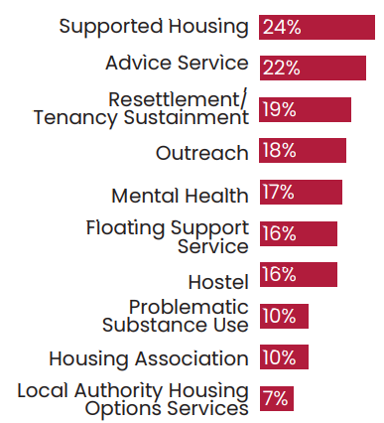
Methodology
Top 10 types of service frontline staff worked in:
Our most recent survey was undertaken in November - December 2022 and we received responses from 1,182 frontline workers across the UK.
We define a frontline worker as anyone directly supporting people experiencing homelessness. This includes those working in the public, statutory and voluntary sectors.
Approximately 1 in 5 (22%) of frontline workers had also previously or currently used homelessness services themselves.

Slide 12

Part 1:
Experiences of frontline homelessness work

Slide 13
Frontline staff are working under extremely challenging conditions.
“If you were getting by before, you are now struggling, if you were struggling before, you are now in crisis.”
Frontline worker, Vale and Cardiff
"[We] seem to be firefighting all the time due to poor funding, staff shortages and lack of affordable accommodation.”
Frontline worker,
South East England
78%
Of frontline workers stated that demand for their service had increased in the last 12 months.
44%
Of frontline workers said it was ‘very difficult’ or ‘difficult’ to have time to undertake training.
32%
Of frontline workers stated that they were struggling to pay housing costs.

Slide 14
This is having a significant impact on staff wellbeing, and threatens to force frontline workers to leave the sector.
The majority (58%) of frontline staff felt that their role had a negative impact on their wellbeing.
Whilst most (68%) frontline workers thought it was ‘very likely’ or ‘likely’ they would continue working in the homelessness sector long-term, the rising cost of living was contributing to increasing uncertainty:
“I love it. I value it. It is worthwhile and ever more important. I just don't know if I can survive it when I have a young family because our work is intense and doesn't pay well!”
Frontline worker, London
“I love what I do and would love to be able to carry on doing it but unfortunately need to be making decisions for my own benefit - it’s hard to support people when you’re also struggling to keep the wolf from the door. I want to have stable accommodation and this income doesn’t provide that.”
Frontline worker, South West England

Slide 15
We need to act now to support frontline services through this cost-of-living crisis.
86% of frontline workers thought services needed additional support to help with the rising cost of living.
“Our service delivery is at risk of reduction due to increase in utility, salary uplifts and other costs which impact on a set funding pot which has not changed for 5 years and is not planned to change in the next 18 months.”
Frontline worker, West Midlands
“We are covering some costs, like fuel, that we should be paid, and we are even personally buying food and other items for people in need.”
Frontline worker, Yorkshire and Humberside

Slide 16

We need to act now to equip frontline workers with the tools they need to do their jobs effectively.
Wider recommendations from staff included improving working conditions, providing more opportunities for training, and implementing reforms and policy changes to prevent homelessness.
"More investment into the staff here and a full staff/management team would mean less churn which would equal a more stable and productive service. Then we could actually look at improving our offer to service users and doing more rather than constantly keeping our head just above water...”
Frontline worker, London

Slide 17

Part 2: Frontline challenges and solutions to addressing homelessness

Slide 18
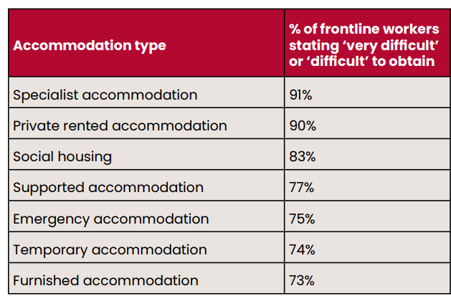
To address homelessness, we need to ensure the right resources are available. This means accessible, suitable accommodation.
"Housing is in huge crisis - any form of affordable housing is incredibly limited and private accommodation within LHA limits, near impossible. Supported accommodation is always full. Social Housing is blocked up and not enough. Much of temporary accommodation is of very poor quality and the landlords charge [Local Authorities] exorbitant amounts."
Frontline worker,
North West England

Slide 19

It also means access to appropriate wider support where needed, particularly around healthcare.
75% of frontline workers stated it was ‘very difficult’ or ‘difficult’ to obtain mental health support for the people they worked with.
“There are very long waits for mental health support and even when people get it it tends to be 6 sessions of CBT which does not meet the needs of those with serious trauma.”
Frontline worker, North West England
“Some of the service users with mental health issues are deemed as not engaging but the support provided has not built a relationship to understand the person.”
Frontline worker, South West England

Slide 20
We need to remove the barriers which stop people being able to access accommodation and support, to ensure services are inclusive of all people.
88%
Of frontline workers reported that long waiting lists ‘often’ or ‘always’ presented barriers when accessing support services for people they worked with.
“Documentation is something the homed take for granted a requirement for housing and financial inclusion."
Frontline worker, Yorkshire and Humberside
“Honestly it’s difficult for everyone across the board experiencing homelessness and [then there is] the intersection of difficulties that often accompany this.”
Frontline worker, South West England

Slide 21
We need to act now to improve practice so people can access effective homelessness support.
Listen to people with lived experience of homelessness and be led by their insights
Make support services easier to access and inclusive of all people
Provide early and quick support to prevent homelessness before it happens

Slide 22

We need to act now to improve policies and prevent homelessness.
The majority (63%) of frontline workers thought that keeping the LHA rate frozen at 2020/21 levels would increase homelessness ‘significantly’ or ‘slightly’ over the next year.
"[We need] Systems (Justice, Education, Council, Housing etc) being more human focused and less budget and cutting costs orientated. If they looked [at] the bigger picture and the long-term preventative benefits of investment rather than always funding / putting resources into 'fighting fires’.”
Frontline worker,
Tayside, Central and Fife

Slide 23
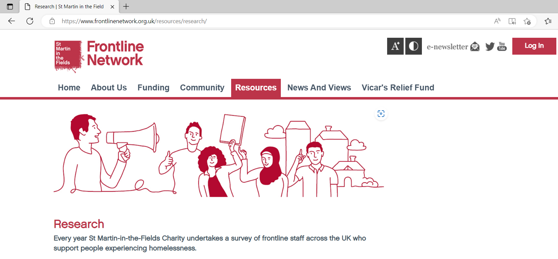

Read more online…

Slide 24

Taking these findings forward

Slide 25

Support for frontline staff

Slide 26
Crowdsourced recommendations…
“Benefit check to maximise income and claim all entitlements" - why not use the Turn2us Benefits Calculator?
Access available grants, for example "Sure Start Maternity grant for first child" - use the Grant Search to explore more options.
"Explore more flex with DHP, not just for people in receipt of benefits but for those with low income" - find out more about Discretionary Housing Payment.
"Look for exemptions from the benefit cap" - read more about who this affects.
Keep an eye out for schemes in your local area, for example "Severn Trent areas - Big Difference Scheme can cut water bills".

Slide 27
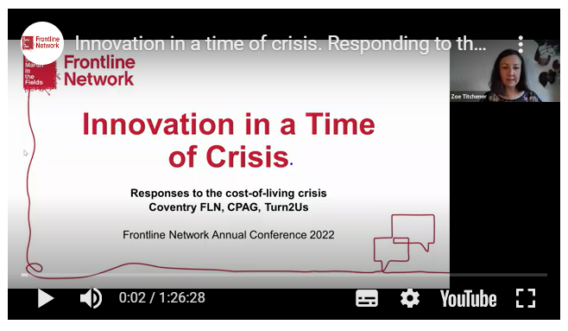
For more resources, check out our website:
Here you can find further details of our Training Fund and upcoming events across the Network, alongside free resources to support you in your work.
And do join us at our next
Frontline Network Annual Conference – save the date
Thursday 29th June!

Slide 28
Thank you and any questions?
Finally, we encourage you to continue sharing your insights into current challenges and solutions related to homelessness and the rising cost of living. This helps build understanding and influence the wider change that is needed. We are committed to amplifying your voices.
If you would like to stay in touch with the Frontline Network, we share various opportunities and updates through our regular e-newsletter.
Find out more: www.frontlinenetwork.org.uk

