Slide 1
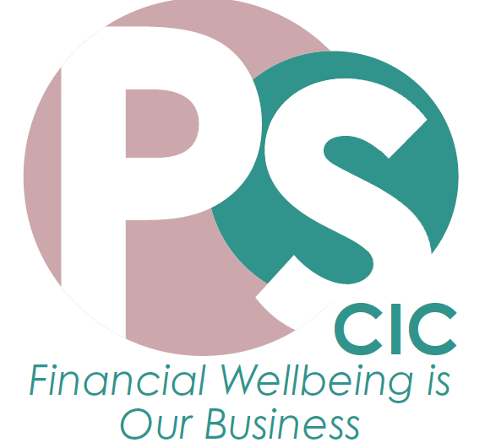
Better Outcomes for Beneficiaries with Money Advice Services
Jayne Bellis Pennysmart CIC
ACO Caseworker Conference 28 Mar 23
Notes:
HEADER SLIDE

Slide 2
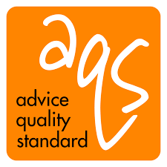
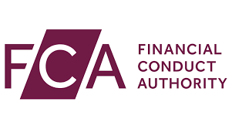
Who are Pennysmart CIC?
A free-to-client, independent, regulated money advice agency set up to work to help vulnerable households escape financial crisis.
Our services are telephone/digital, referrals-only, based in Chester; we work across UK as required.
See www.pennysmart.org.uk for more information

Slide 3
UK Cost-of-Living Crisis Quiz:
According to fuel poverty charity National Energy Action (NEA) 4 million households were fuel poor in 2020. But how many are they estimating it will be by April 2023?
A. 5 million B. 6 million C. 7.5 million
UK food prices are rising at the fastest rate in over 40 years. But how high was it in the latest figures released in January 23?
A. 16.8% B. 12.3% C. 11.1%
Interest rates and the cost of borrowing highest since credit crunch
What did the Bank of England raise rates to this month (Mar 23)?
A. 3.75% B. 4.25% C. 4.75%
3.5 million over 50’s have remained economically inactive since the pandemic. That means they are out of work but not looking for work. What is reported in the press as being the main reason for this:
A. Unable to get jobs B. Ill health C. Early retirement

Slide 4
Some Reasons Money Advice & Support can help:
Rather than using funds to bridge income shortfalls, benefits advice could help to identify unclaimed entitlements and resolve budget shortfalls in the longer term.
Budgeting advice can be used to help regain control of finances, understand the complexities of erratic or self-employed income and develop strategies to cope and weather financial shocks.
Debt advice can be effective to explore statutory and other debt remedies such as Debt Relief Orders, Debt Management Plans or temporary arrangements, rather than using grants to directly clear outstanding balances
Money advice & support can provide leverage of benevolent funds in excess of £9 financial gains for every £1 of funding.
Notes:
CONTACT DETAILS:

Slide 5
Money Advice Options:
Make referrals to existing mainstream money advice providers, ideal for zero cost, however casework support, service levels and reporting capabilities can be unpredictable/limited.
Bring benefits and regulated debt advice provision in-house, most larger charities opt for this, gives a 5 star solution, but can be resource hungry to maintain.
Engage freelance providers, many charities opt for this solution, but can be risks around compliance, regulation and standardised outcomes and reporting
Become a partner with Pennysmart CIC, gives the tailored approach of an in-house team, full casework support based on client-need, case-level outcome reporting without the ongoing cost and compliance burden falling to the charity.

Slide 6
What do Pennysmart CIC do?
Contract with Charities, Social Landlords & healthcare Providers to deliver budgeting, benefits & regulated debt advice with casework support services.
Create and deliver money themed training for frontline staff supporting those who struggle with money
Provide Financial Wellbeing programmes, consultancy and events

Slide 7
How PS Money Advice referrals can help:
Help clients make ends meet by maximising income; claiming benefits and reducing bills
Help to make money last until payday by setting money aside and prioritising bills
Help to pay bills on time and in full by setting up workable payment arrangements.
Deal with problem debt by accessing an appropriate solution for client’s circumstances
Regain control of finances, feel less stressed about money and improve overall wellbeing

Slide 8
THE PS MONEY ADVICE JOURNEY
Referral received into service via digital portal, email, post, SMS or phone
Client contacted within 48 hours telephone appointment set
Full Money Health Check carried out
Money Advice given and summary of advice pack provided to client.
Full report sent back to referring officer for implementation
Casework support service for WB; Debt and/or Money Management where required

Slide 9
Kelly’s Story:
Kelly was a self-employed hairdresser for 10 years; following a car accident she suffered severe injury and was unable to work. She relied on credit cards and payday loans to pay bills, cover living costs whilst she was without income, but became desperate when she started to struggle to meet the monthly repayments. Kelly approached a charity for a grant of £10,000 to pay off her debts. They referred her for money advice before making a decision.
Her money adviser identified that she should be claiming £1189pm Universal Credit; £100pm Council Tax Support and recommended a claim to PIP.
The adviser also advised if she was likely to go back into work then temporary token offers could be made to her creditors. Or, of she was unlikely to be able to work again she might consider a Debt Relief Order to clear the debts in full and was able to lay out pros and cons of each for her to decide the best option.
The charity agreed to help fund Kelly to retrain as a hairdressing lecturer instead.

Slide 10
Any Questions?

Slide 11
Please get in touch:
For further service and pricing details:
Jayne Bellis
PS CIC
Twitter @PennysmartCIC
Email: business@pennysmart.org.uk
Tel: 07950377531

