Slide 1

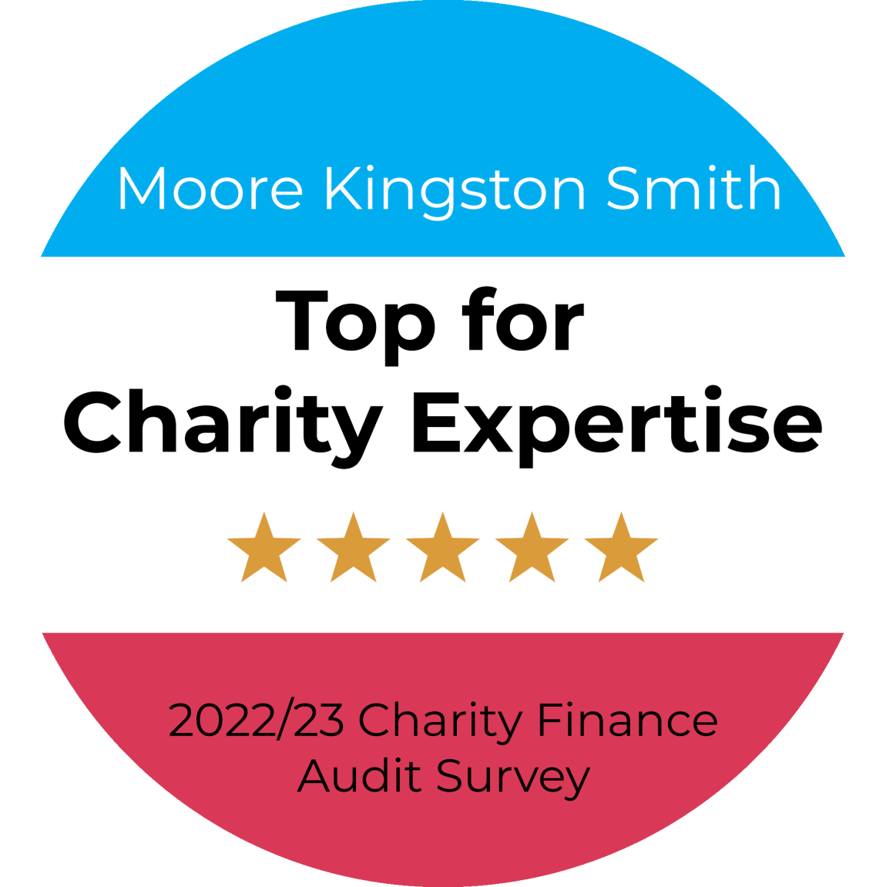

ACO Finance Forum – Technical and Charity Sector Updates
Luke Holt, Partner, Moore Kingston Smith
Sam Edwards, Senior Manager, Moore Kingston Smith
16th November 2023

Slide 2


Introductions
Luke Holt EXON BFP FCA DChA
Nonprofit Partner
T: 0204 582 1510
M: 07791 809 379
E: lholt@mks.co.uk
Sam Edwards ACA DChA
Nonprofit Senior Manager
T: 0204 582 1619
E: s.edwards@mks.co.uk
Notes:
BEN Motor
Bank workers trust
CILEX
GroceryAid
HWCT
Help for Heroes
NHS Charities
RAF Benevolent Fund
RABI
The Society of Authors
IMECHE Support Network
Turn2Us

Slide 3
Agenda – Technical and charity sector updates
The sector press over the past 6-12 months – risk?
Governance and risk – what are we seeing from our reviews?
The risk of fraud and cyber fraud
CC8 and CC14 – back to basics and investment conundrums
The risk of change and complexity – FRS 102 and the Charity SORP
Emerging and accelerating risks – E(E)DI and ESG
Time for questions (if we’ve spoken fast enough!)….

Slide 4
THE SECTOR PRESS….

Slide 5

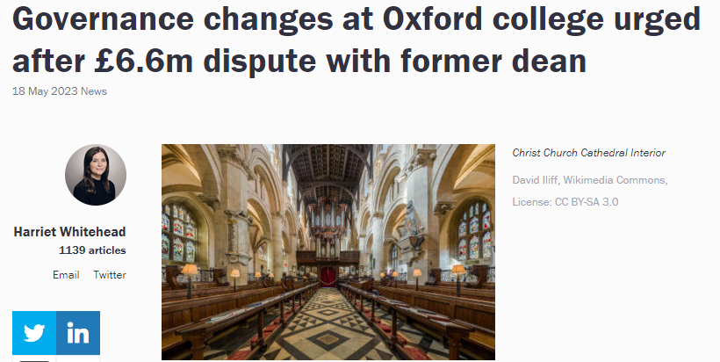
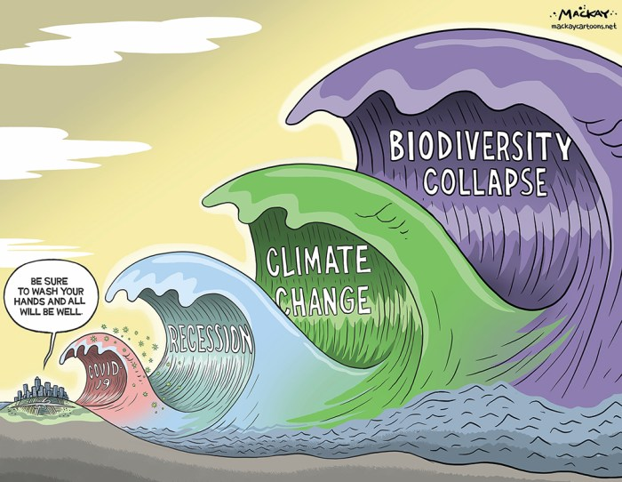
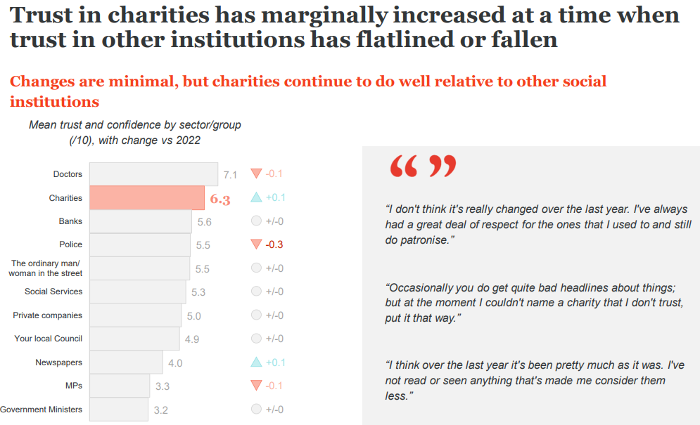


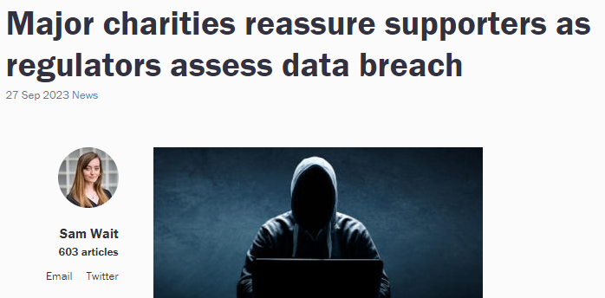
The Sector Press, setting the scene………
mackaycartoons.net
Notes:
Cost of giving crisis - Support for charities
Our latest research reveals the alarming extent of the crisis facing our sector this winter.
With costs climbing, funding falling and demand increasing, this is not just a cost of living crisis. For charities, this is a Cost of Giving Crisis.
85% of charities we spoke to in a recent survey said this winter will be as tough – or even tougher (54%) – than it was last year. If our sector doesn’t get the support it urgently needs, 1 in 5 charities could be forced to close until things improve, leaving people and communities at risk.
ADD MORE XXXX

Slide 6
GOVERNANCE AND RISK IN ACTION (AND INTERACTION) -

Slide 7
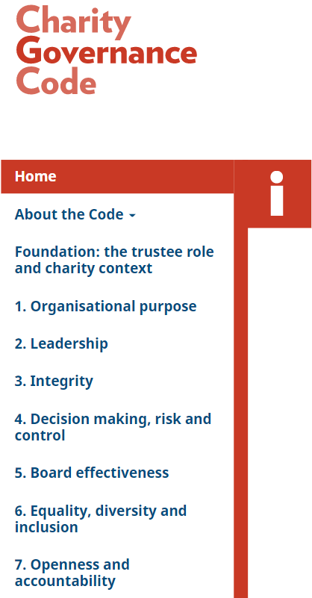
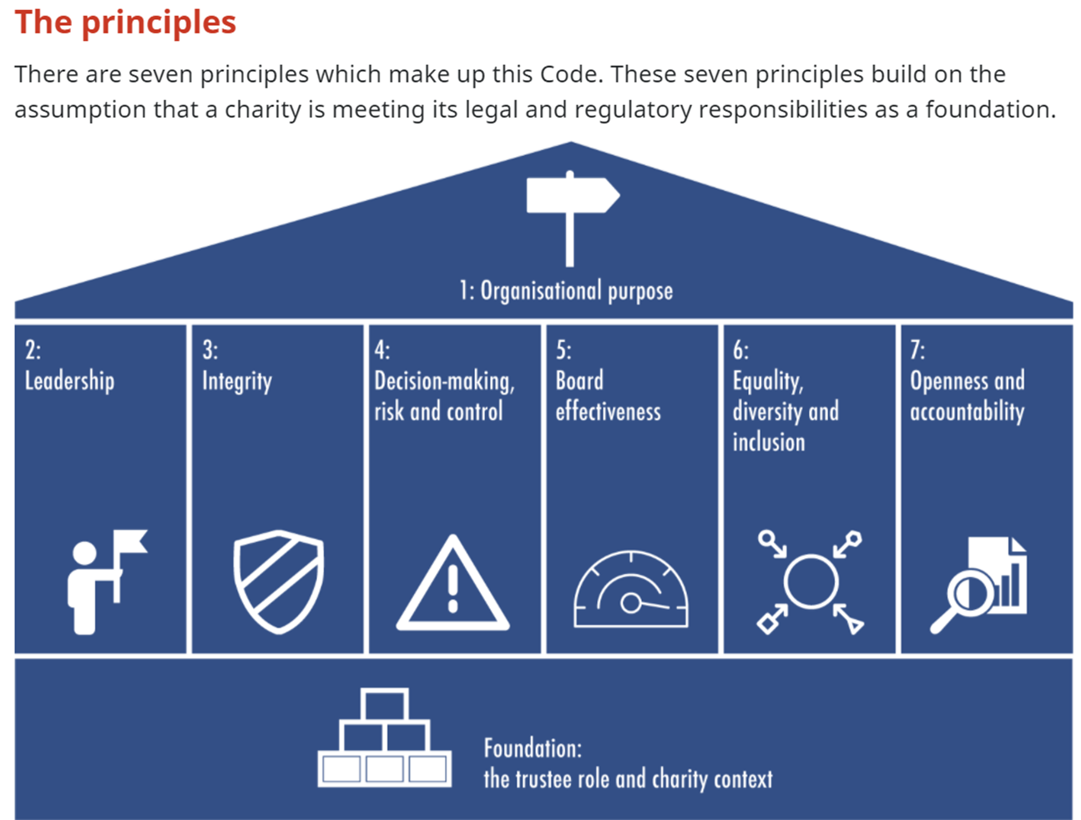
Charity Governance Code
Notes:
We’ve included this slide as a quick reminder of the latest version of the CGC (Dec 2020) as we’ll refer to the CGC Principles where relevant in the next few minutes, drawing on the our experience (during governance reviews) of what’s being done well, and what’s still challenging in the sector.
We can’t go through each principle and recommended practice but would strongly encourage you / your boards to looks at this – as an exercise ‘in total’ or as a staged process looking at 1 or 2 Principles in turn.
Link to your strategy discussions / Board ‘away days’ or regular Trustee training.
You may also be familiar with guidance from the Chartered Governance Institute UK & Ireland (CGI):
Improving Charity Boardroom behaviours (April 2021) – links to each Principle of the Code
The 12 elements of independent judgement for a UK Board: A guide for Directors (July 2021)]
The Code comprises 7 Principles built around the ‘Foundation’ – trustee role and context (based on CC3 guidance Essential Trustee)
CGC - developed ‘by the sector, for the sector’
NOT just for larger charities, though application / best practice will vary according to your size and nature
Not a legal or regulatory requirement, hence ‘apply or explain’ not ‘comply or explain’
CGC draws upon, but is fundamentally different to, the Charity Commission’s guidance
The Code’s Principles, Rationale and Key Outcomes apply to all charities, although the Recommended Practice to meet the Principles will vary for all charities
CGC reflects slightly different Recommended Practice for smaller / larger charities – 2 versions although in practice very little difference
Check CGC website – we’ve provided the link, plus there is also a downloadable ‘diagnostic tool’ (Word)

Slide 8
Governance and risk - KEY themes
Behaviour and decision-making
  Conduct and values – ‘tone from the top’ and the SLT/SMT relationship with the Board. How is yours…..?
  Decision-making – CC27 is a helpful reminder
  Conflicts of interest / loyalty – policy and practice (hot topic in recent Charity Commission reviews)
A recently reviewed delegation framework and efficiencies
  Drives Committee and SLT/SMT structures and ToRs
  Papers for meetings – front sheets, exec summaries and not 400+ pages
Risk management and risk appetite
Financial and investment governance
  Responding to the new Annual Return questions
  Role of the updated CC8 guidance and checklist – more on this later
  Embracing the revised CC14 guidance – more on this later
  Due diligence around corporate partnerships / gifts / ex-gratia payments / fundraising
Notes:
How will your charity respond to the new AR questions on Governance, Safeguarding and Risk

Slide 9
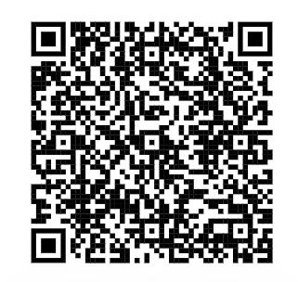

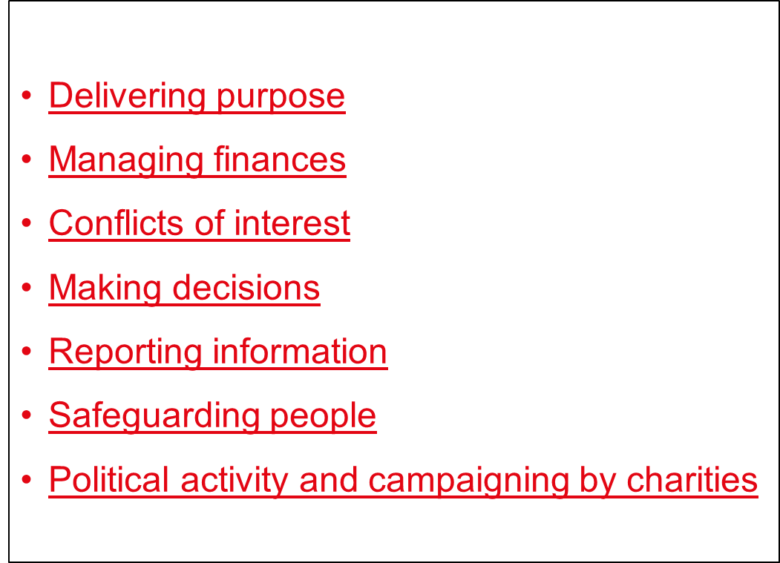
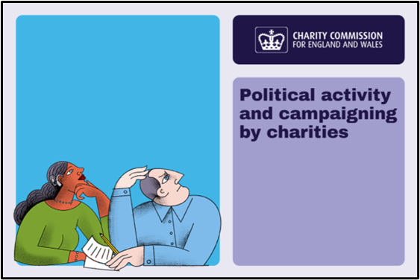

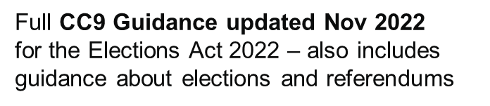
Charity Commission 5 - minute guides for trustees
https://www.gov.uk/government/collections/5-minute-guides-for-charity-trustees
Plus:
New social media guidance issued 18.9.2023
Notes:
Development of the Guides and the accompanying short videos (since Nov 2020, with the SG one added in Nov 2021)) is in line with CC’s objective to provide more easily accessible core guidance for trustees – good ‘gateway guidance’ for experienced trustees as well as those new to the role; complement the fuller CC3 ‘Essential Trustee’ guidance
Signpost to longer-form guidance and other resources from sector bodies, including updates arising from Charities Act 2022 implementation, which Paul will be speaking about shortly
The 7th 5-minute guide, on political activity, was launched in October 2022 in the context of the importance of charities being able to make meaningful change in society. The full CC9 guidance, on which it is based, was updated in November 2022.
Trustees are responsible for making sure their charity follows the rules on political activity and campaigning, and for making sure that staff and volunteers working on campaigns understand the rules, even if Trustees delegate the day to day decision-making and activities.

Slide 10

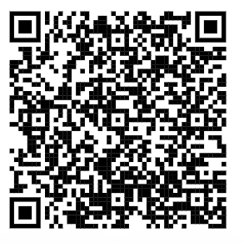
Charity Commission – Trustee Quiz
Might be a good addition to induction, interview or re-induction……..
Take the trustee quiz (beingacharitytrustee.campaign.gov.uk)

Slide 11
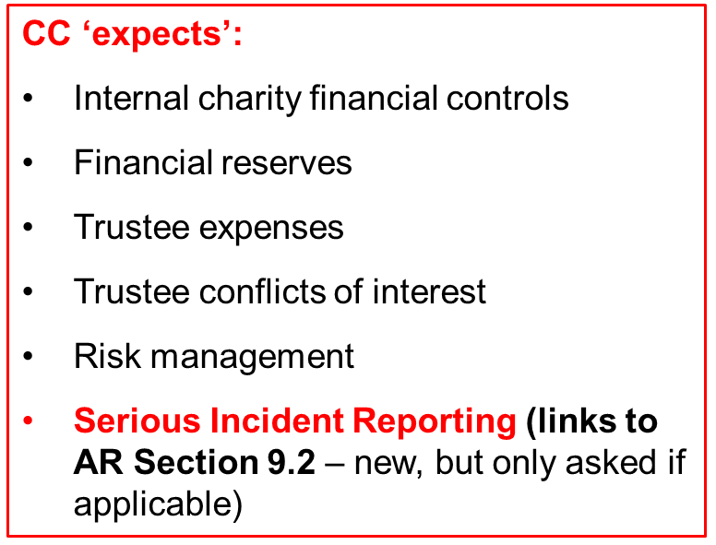
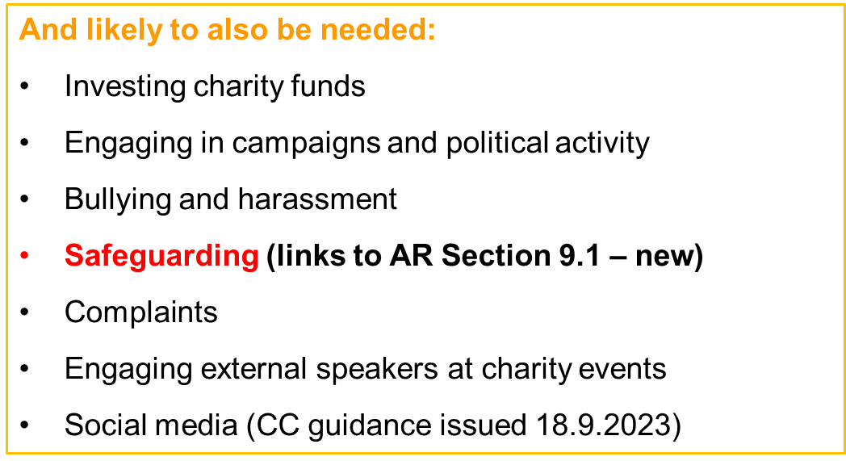
Charity Annual Return 2023: Governance
Can you lay your hands on these policies for your charity? Are they up to date, reviewed and approved appropriately? Links to your charity’s ‘Matters reserved for the Board’ and delegation framework to Committees, staff etc.
Notes:
Leave in for reference but skip over this slide

Slide 12
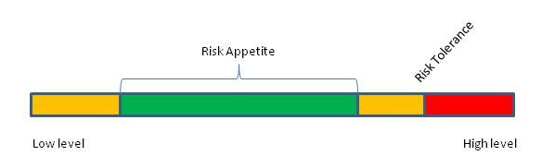
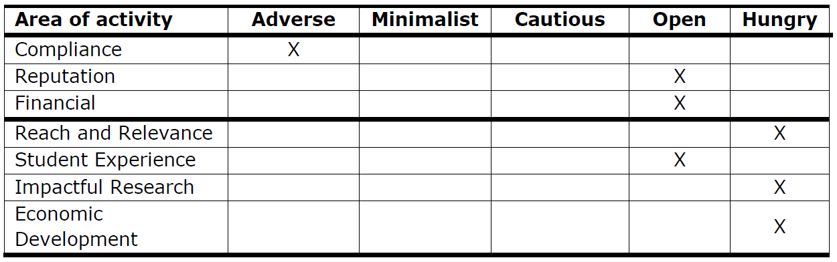
Risk appetite – example disclosures
Risk appetite policy and disclosures
“Risk Appetite” disclosure or policy
When did you last have a Risk Appetite discussion?
A documented policy?
If not, how do you know:
- which risks you are taking and “happy with”
- which risks are you taking that you aren’t!
Conclusions of “net risk” on a risk register
- and they don’t all have to be Green
Notes:
“Risk Appetite” disclosure or policy
Hands up if you have had a risk appetite discussion in the past 12 months?
Covid and the last 2 years of operating under the pandemic, will ALMOST DEFINITELY have changed your outlook on risk and risk appetite.
Do you have a documented policy?
If not, what tends to happen is you keep doing the “green risks” because they’re low risk, but could be missing “the opportunistic orange or red risk that you do actually have an appetite for”.
Conclusions of “net risk” on a risk register should be after taking into consideration the gross risk, your risk appetite and the net risk after mitigations/controls.

Slide 13
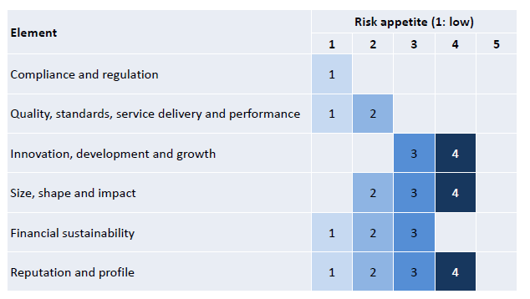
Risk appetite – example disclosures
Risk appetite policy and disclosures
Notes:
Example RISK APPETITE DISCLOSURE (NOW BECOMING MORE COMMON PLACE IN THE HIGHER EDUCATION WORLD)

Slide 14
THE RISK OF FRAUD AND CYBER FRAUD

Slide 15

The threat to charities and the third sector
“All charities ultimately rely on public trust and continued public generosity.
So, the impact of any cyber attack on a charity can therefore be devastating, not just for the organisation and those who rely on its services, but also in undermining public confidence and support.
Taking steps to stay secure online is not an optional extra for trustees, but a core part of good governance.”
Helen Stephenson
(Chief Executive, Charity Commission for England and Wales)

Slide 16
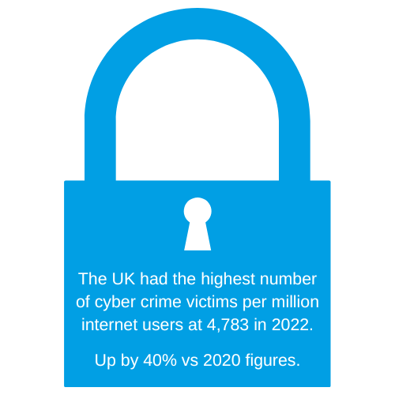
The cyber threat in 2023
69% of employees have bypassed their organization’s cybersecurity guidance in the past 12 months
74% of employees said they would be willing to bypass cybersecurity guidance if it helped them or their team achieve a business objective
50% of IT leaders confirm that their cybersecurity budget fails to meet the minimum figure they need to remain on track with their security goals
70% of leaders believe ransomware poses their greatest cyber threat in 2023.
DATA: GARTNER, IT PRO AND ARCTIC WOLF SURVEYS

Slide 17
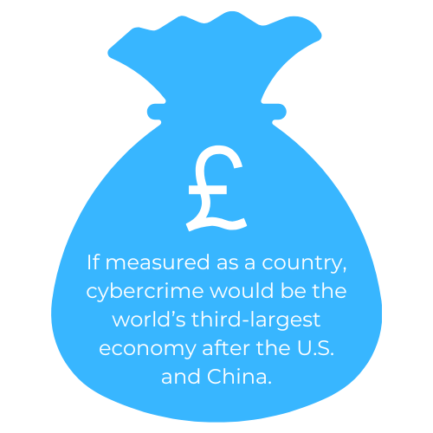
The nonprofit cyber threat in 2023
Cyber attacks on UK organisations surged 77% in 2022
UK charity sector saw a 237% increase in attacks compared to 2021
Benevolence / health / research charities experienced a weekly average of 2,653 attacks
UK organisations experienced an average of 788 weekly cyber attacks across 2022
Escalation driven predominately by smaller, more agile threat actors and sophisticated ransomware gangs.
DATA: GARTNER, IT PRO AND ARCTIC WOLF SURVEYS

Slide 18
Motives for attacking charities and the third sector
England and Wales: 169,029 registered charities, combined annual income of £83.8 billion
Scotland: 24,020 registered charities, combined annual income of £13.6 billion
Northern Ireland: 6,691 registered charities, combined annual income of £2.3 billion
UK = £99.7 billion industry
Collect huge volumes of personal data from customers, donors or stakeholders
Often share data with external organisations such as marketing companies
Cyber criminals and other groups may be able to gain access to charities’ networks and/or information through these companies (supply chain risk is key in cyber security).

Slide 19
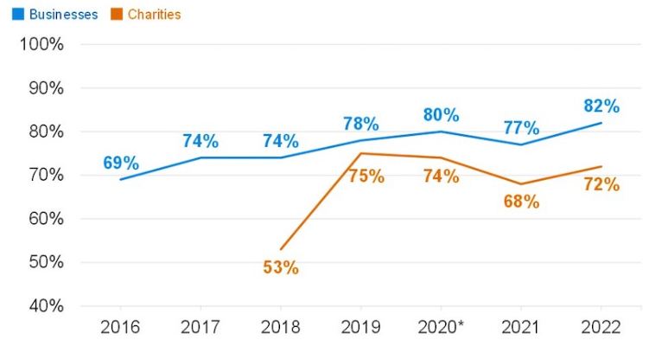
Governance and Trustees
The Board is responsible for making sure a charity is taking appropriate measures to protect itself from a cyber attack
Not the IT department, or third-party providers
Board members don’t need to be technical experts
You do need to know enough about the importance of cyber security, to enable educated discussions and collaboration with key staff
Charities 6-7 years behind “Businesses”.
NCSC Cyber Security Breaches Survey 2022:
% of organisations over time where cyber security is seen as a high priority for directors, trustees and other senior managers:

Slide 20

Key steps: Mitigate and manage your risk
Key steps to reduce your organisation’s cyber security risk:
Education, training, awareness and employee diligence – strengthen the ‘human firewall’
Obtain Cyber Essentials/Cyber Essentials Plus certification to make sure basic cyber hygiene is in place
Make sure your IT systems are “secure by design”
Get to know your suppliers and their cyber security posture
Plan for the worst - define and test your organisation’s cyber incident response (penetration test and “test phishing” emails).
Human
Firewall
Cyber
Essentials
ANTI
VIRUS
Response
Planning
PATCHING
Secure by Design
Supply Chain Security

Slide 21


The most common non-cyber frauds and mitigating actions
Key controls to prevent, reduce and mitigate fraud:-
Supplier mandate and bank detail changes
Batch supplier duplications
Fraudulent staff/ “ghost employees” / temp staff costs
Email takeover
Fraudulent grant applications / multiple applications.
ANTI
VIRUS
Response
Planning
PATCHING
Secure by Design
Notes:
“Supplier mandate fraud”
Contact is made from a “supplier” employee who is noting (either by phone or official headed notepaper) a change of bank details. The bank details are fraudulent.
Control to mitigate the risk – review and approval of all standing data supplier changes and calls to confirm BEFORE updates processed.
“Batch supplier duplication”
An example of an internal fraud – the details of a supplier are duplicated onto the system and the duplicate given the fraudulent parties bank details. “Real invoices” are paid twice, hidden in the batch run, once real and once fraudulent.
Controls to mitigate the risk – Approval of new suppliers and monthly management accounts reviews. The additional payment debit will need to be either to a balance sheet code or will be seen through an inflated expense code on the SOFA.
“Fraudulent staff/temp staff costs”
The fraudulent party continues to pay staff after they have left (using updated fraudulent bank details), enrols ghost employees for payment or processes fake invoices through “busy” nominal codes such as temp staff costs.
Controls to mitigate the risk - This fraud is almost always discovered through a review of management accounts vs budgets. Preventive controls would include approval of staff detail changes and “lock down” on leavers details in a timely fashion.
“Email takeover”
An internet based fraud that is expanding rapidly (and becoming more sophisticated). The finance team receive an email “from” the FD/CEO usually late afternoon, indicating they have forgotten to pay a key supplier and it should be paid immediately.
The email is fraudulent and so are the bank details given.
Controls to mitigate the risk – Communication by phone or face to face to confirm details. Do not allow payments to supplier details that do not match those saved on the standing data.

Slide 22
CC8 AND CC14

Slide 23

CC8 Internal financial controls
Guidance and checklist (updated April 2023)
The Guidance reminds trustees of their responsibility for their charity’s financial management and for implementing and monitoring their charity’s internal financial controls, even if the detailed work is delegated
  Reminder of general controls principles applicable to all charities
  Updated section on operational risks and examples
  Internal control ‘basics’ for key areas
How should you use the Checklist?
How do you / the Board know the controls listed are actually operating effectively, and working in practice?
Notes:
Long awaited update!
Starts off with a reminder of the general principles for all charities, for example:
controls must be ‘appropriate’ and should be ‘embedded’ (awareness, training, compliance)
monitor the charity’s internal controls – at least once a year
split financial duties between people – challenges / options
trustees should have access to up to date, clear, accurate financial information
monitor the charity’s financial performance regularly
trustees’ legal duty to:
keep accounting records
prepare an annual report and accounts
record and report incidents
The CC is encouraging trustees to read through the new guidance and use the downloadable checklist to help identify and address any gaps in controls. Straightforward and could be seen as too simplistic for some charities (yes / no boxes), but does provide a good trigger for highlighting areas for further investigation / action
Not all the controls on the checklist are relevant for all charities, and the systems and processes operated by larger charities will typically go significantly over and above the processes set out on the checklist.
The Checklist should be completed by a member of staff responsible for finance processes and reviewed at board level - annually. It is a good starting point for identifying financial control gaps and you should always review the guidance if and when new issues arise. But the Checklist needs to be accompanied by an assessment of the quality and effectiveness of those controls, not simply whether or not those controls exist. The Board should ask – how do we know?
We recommend you also add a ‘Not Applicable’ column; Comments sections; ‘Reviewed by’ / date; Date for next review.
Ensure ‘IC’s are firmly on the Board’s agenda, perhaps linked to a summary Board assurance Framework.

Slide 24
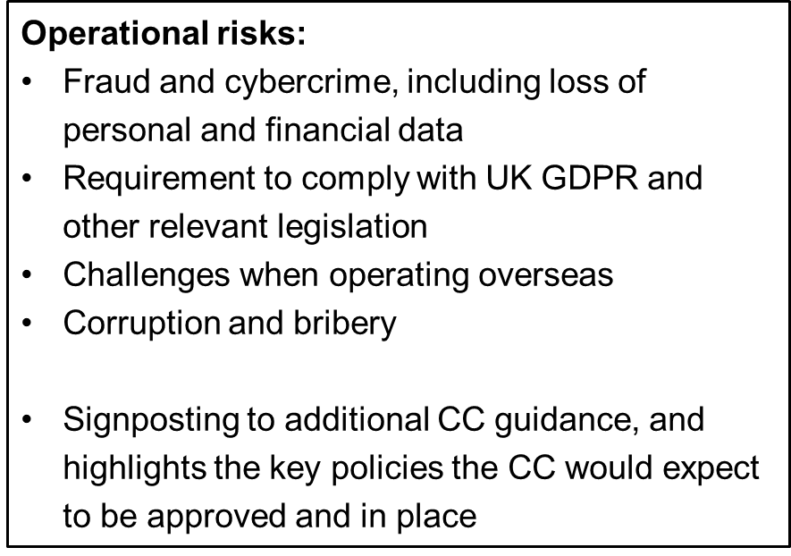
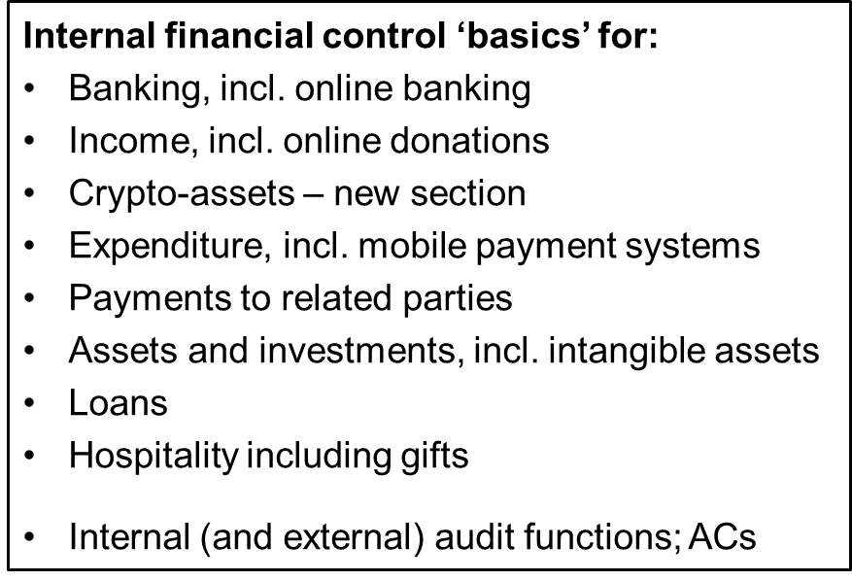
CC8: Risks and controls
Notes:
Keep in the slide pack but skip over this quickly, link to importance of risk management and good governance practice (CGC P4 on decision-making, risk and control) – and the ‘how do you know?’ question
There is FRAUD in your organisation!!

Slide 25
CC14 Investing charity money: guidance for trustees (August 2023)
CC14 explains what trustees need to know and do to make financial and social investment decisions in line with their trustee duties
Accommodates the ‘Butler-Sloss’ judicial review outcome (2022)
CC14 now has a simpler structure and is easier to interpret; shows how to consider ‘ethical’ factors as part of the trustees’ investment approach, whilst also considering financial return
Uses simpler language to describe ‘social investments’
Highlights the need for trustees to consider taking advice (or be clear why it isn’t needed, and keep a record of that), and to be prudent, whilst also considering loss of donors or reputational risk.
Notes:
The Charity Commission issued its revised CC14 guidance on Investments in August 2023.
Long time in the making having been deferred to accommodate the outcome of what’s referred to as the ‘Butler-Sloss’ case in April 2022.
Trustees should keep investments and their investment approach under regular review and have a clear investment policy – even if the charity only has cash e.g. in a savings or deposit account.
CC14 Uses simpler language to describe ‘social investments’ i.e. where charity trustees invest money / property with a view to achieving the charity’s purposes as well as for financial return
CC14 includes examples of acceptable practice to ensure decision-making is in line with trustees’ overall duties to:
further the charity’s purposes i.e. by investing to support the delivery of the charity’s purposes over time
comply with legal duties and requirements
make decisions in the best interests of the charity
act with / use reasonable care and skill (duty of care; prudence; taking advice)
Also highlights specific trustee duties when making financial investments, and when considering social investments
Reinforces wider principles of effective decision-making, links to CC27 referred to earlier
Commentary on the steps trustees ‘must’ take legally, and ‘should’ take for best practice

Slide 26
FRS 102 AND THE CHARITY SORP

Slide 27
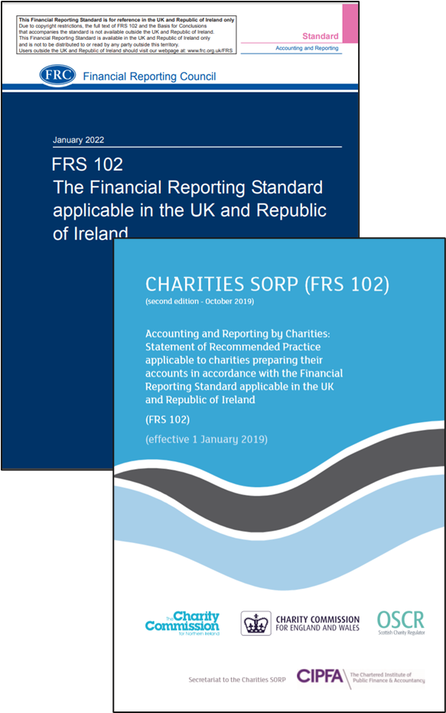
FRS 102 and the Charity SORP
For charity accounts showing a ‘true & fair view’, the two key ‘ingredients’ are currently:
FRS 102 (Jan 2022)
Underpins charity (and other) reporting in the UK
Awaiting publication of the revised FRS following the consultation on FRED 82
Effective date for revised FRS 102 is reporting periods beginning on or after 1 Jan 2026 (so 31 December 2026 or 31 March 2027 for most in the room)
2. Charities SORP (FRS 102) 2nd edition (Oct 2019)
Being revised in line with the revised FRS 102 – timeline?
Notes:
Accruals accounts i.e. those showing a T&F view. Not applicable for R&P Accounts.
FRED 82 consultation on revisions to FRS 102 now closed, but engagement from charity professionals remains important
Key issues include:
Revenue recognition esp. for ‘contracts’; ‘non-exchange’ transactions – charity sector sit on different income streams, must be mindful of whether alignment to IFRS means change to charity income principles e.g. entitlement, probability measurement – how much will these be challenged
Lease accounting – significant / onerous changes for charities if lessees are required to recognise all leases on the balance sheet (limited exceptions, and no option for charities to apply FRS 105 instead) . Fully expecting op leases to be treated the same as Finance leases and go on BS
Resource and training needs; proportionality re small charities
Can view the response to the consultation on the Financial Reporting Council website (frc.org.uk)
54 responses published on FRC’s website, including from ICAEW; Charity SORP-making body; CFG; other charity specialists and accountancy firms [NB can’t see MKS did one?]
The Charities SORP provides interpretation of FRS 102 and UK GAAP as it applies to charities, plus additional requirements
Also needs to be revised in line with the revised FRS 102, being considered by the Charity SORP Committee also taking into account the feedback from wider stakeholder engagement exercises – tricky balancing act esp to address compliance needs vs proportionality for smaller charities

Slide 28
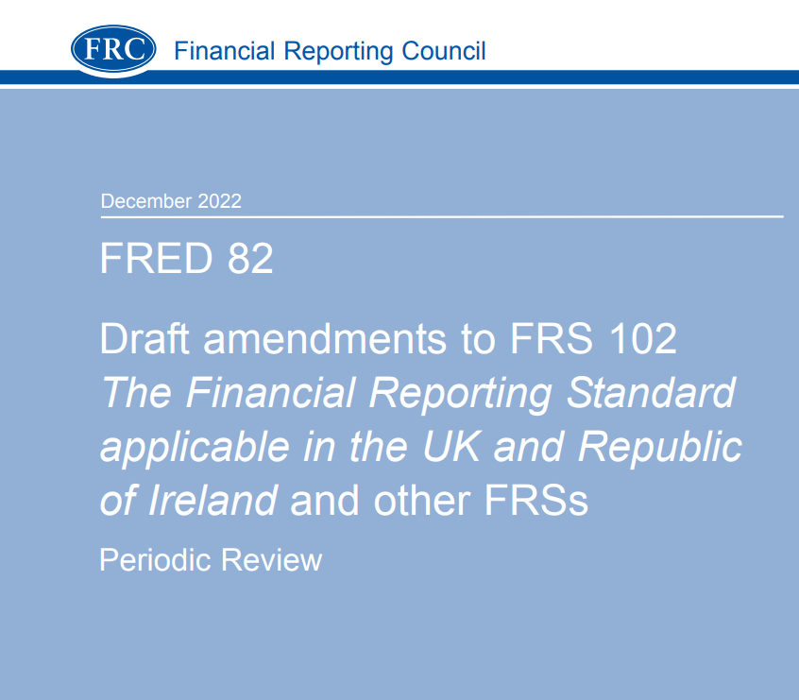
FRS 102 and the Charity SORP
FRED 82 consultation on revisions to FRS 102 now closed
Engagement from charity professionals remains important as the next version of FRS 102 will continue to form the foundation for the next Charities SORP
Key issues include:
  Revenue recognition esp. for ‘contracts’; ‘non-exchange’ transactions (donated goods and facilities)
  Lease accounting – significant / onerous changes for charities if lessees are required to recognise all leases on the balance sheet (limited exceptions, and no option for charities to apply FRS 105 instead)
  Impact reporting, ESG, Charity Governance Code, EDI – will any of these be mandated
  Concepts of proportionality, complexity and comparability throughout….
  Consultation on the next SORP expected in mid to late 2024
Notes:
Accruals accounts i.e. those showing a T&F view. Not applicable for R&P Accounts.
FRED 82 consultation on revisions to FRS 102 now closed, but engagement from charity professionals remains important
Key issues include:
Revenue recognition esp. for ‘contracts’; ‘non-exchange’ transactions – charity sector sit on different income streams, must be mindful of whether alignment to IFRS means change to charity income principles e.g. entitlement, probability measurement – how much will these be challenged
Lease accounting – significant / onerous changes for charities if lessees are required to recognise all leases on the balance sheet (limited exceptions, and no option for charities to apply FRS 105 instead) . Fully expecting op leases to be treated the same as Finance leases and go on BS
Resource and training needs; proportionality re small charities
Can view the response to the consultation on the Financial Reporting Council website (frc.org.uk)
54 responses published on FRC’s website, including from ICAEW; Charity SORP-making body; CFG; other charity specialists and accountancy firms [NB can’t see MKS did one?]
The Charities SORP provides interpretation of FRS 102 and UK GAAP as it applies to charities, plus additional requirements
Also needs to be revised in line with the revised FRS 102, being considered by the Charity SORP Committee also taking into account the feedback from wider stakeholder engagement exercises – tricky balancing act esp to address compliance needs vs proportionality for smaller charities

Slide 29
EMERGING AND ACCELERATING RISKS – EDI AND ESG………

Slide 30

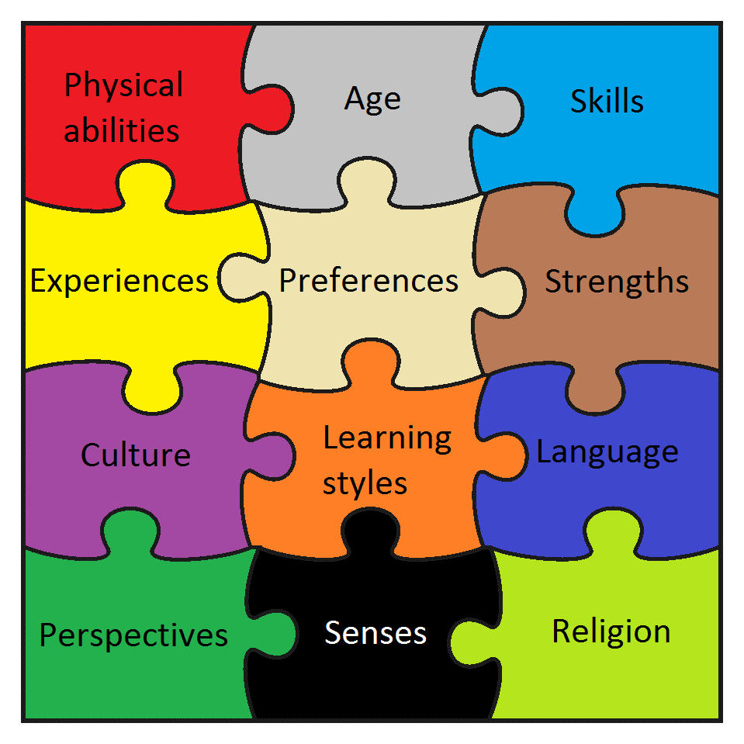
Equality, (Equity), Diversity and Inclusion
Notes:
Moving on to a quick update on Equality Diversity and Inclusion
Feel like this has been a topic of consideration and “action” / STANDING AGENDA ITEM for a while now
BUT what, in my opinion, has changed so much since the last time I presented to you all in 2020 is the depth of information, case studies and guidance that is now out there in the sector.

Slide 31

Equality vs Equity
Notes:
Many of us in the room are accountants and will understand the term Equity but this is a different definition
Equality – looking to treat everyone the same
Equity – not treating everyone the same (a different bike depending on the circumstances) but looking to ensure “the same outcome for everyone”.
Equality versus Equity – an important concept often forgotten in the sector?

Slide 32



Equality, (Equity), Diversity and Inclusion
3% of Trustees are below 30
0.04% of Trustees are 18 or younger
8% of sector Trustees are called Paul or John!!!!
Notes:
NOW BEAR WITH ME – THESE ARE 2020 STATS AND HAVENT BEEN UPDATED, BUT I WOULD EXPECT THEY HAVENT MOVED “THAT MUCH” – SO CAN SEE THE ISSUE IN THE NON PROFIT SECTOR:
3% of Trustees are below 30
0.04% of Trustees are 18 or younger
8% of Charity sector Trustees are called Paul or John!!!! MORE OF MONOPOLY OF THE SECTOR THAN THE NAMING OF POPES!!! (OVER 60,000 TRUSTEES)!

Slide 33
Equality, (Equity), Diversity and Inclusion - progress
“Some boards create a false binary between diversity and skills, presenting a situation where either diversity is trumped over the skills needed or vice versa. This is not how we would urge a Chair to approach recruiting for diversity.”
Third Sector ‘Bleak picture’ as only half of charities seeking to recruit more diverse trustees – 14% fall on diversity targets being met for those that have them in place
https://www.thirdsector.co.uk/bleak-picture-half-charities-seeking-recruit-diverse-trustees/governance/article/1846415
The joint AGBIS and Farrer & Co publication “Towards an Equality, Diversity and Inclusion Strategy” - https://www.agbis.org.uk/asset/8F230B4A-A192-468F-8DDA0C7394BB6279/
“From Here to Diversity” practical guide from the Action for Trustee Racial Diversity” - https://atrd.group/wp-content/uploads/2021/09/From-Here-to-Diversity-A-Practical-Guide-on-How-to-Recruit-Black-and-Asian-Charity-Trustees.pdf
#iWill publication “Getting Young People onto your Trustee Board” - https://www.iwill.org.uk/young-trustees-guide
“Diverse recruitment isn’t just picking one of each protected group
“You will make mistakes”
Notes:
- GOVERNANCE AND LEADERSHIP MAGAZINE – THE CONCEPT OF AN “EQUITY AUDIT” AMONGST MANY OTHER EXCELLENT IDEAS TO HELP YOU ON YOUR EDI JOURNEY
AGBIS AND FARRER PUBLICATION (HOLD IT UP!) – In the Wake of Black Lives Matter and Everyones Invited – Includes a checklist for a “Whole School Approach” to EDI – a very good read!
FROM HERE TO DIVERSITY FROM THE ATRD – ACTION FOR TRUSTEE RACIAL DIVERSITY – 60 EXCELLENT PAGES OF GUIDANCE AND ONE OF MY FAVOURITE QUOTES IN THIS AREA (COMING UP IN A SECOND)
IWILL – Getting young people on your Trustee Board “Including young people from diverse backgrounds on your board doesn’t just benefit the young person involved. It brings creative and unique perspectives to conversations that can influence outcomes to the benefit of your team and your beneficiaries. Not only this, but it helps you address the well-worn issue of board diversity (or lack thereof).” 6 PAGES – GOOD FOR THOSE OF YOU WHO LIKE GUIDANCE AS BEING CONCISE (OR JUST LESS READING!) OR YOUNG PEOPLE TODAY WONT READ OR WRITE A 60 PAGE DOCUMENT!

Slide 34

Environmental, Social and Governance (“ESG”)
We could do a full 3 hour presentation on the risks and mitigations around this area, so instead, here are a few helpful links instead to continue your ESG journey:-
ESG Maturity matrix - ESG: https://www.cgi.org.uk/knowledge/research/esg-maturity-matrix-charities
Sustainability Reporting Standard - https://sustainabilityforhousing.org.uk/
UN Global Compact – 10 Principles - https://unglobalcompact.org/what-is-gc/mission/principles
Moore Kingston Smith ESG Team - https://mooreks.co.uk/services/advisory/environmental-social-and-governance-esg/

Slide 35

THANK YOU – ANY QUESTIONS?

Slide 36
Moore Kingston Smith – About us
London firm of top 10 accounting and advisory network, Moore UK. A global family of over 34,000 professionals across 228 independent firms working in more than 110 countries.
We are one of the leading firms auditing and advising the charities sector. Our charity team have been voted top for charity expertise in Charity Finance’s 2022/23 audit survey. We also maintain our position as one of the leading firms delivering outstanding service.
Our commitment to the sector has extended to developing specialist resources and capacity and investing in a suite of unique services for charity and other nonprofit profit organisations. This includes our data transformation IT services, Governance services, GDPR data protection offering, specialist nonprofit tax and VAT specialists, our ESG services and MKS Nonprofit Advisory, who provide advice on fundraising, impact reporting, value for money and cost recovery reviews.
This year, we celebrated our 100th anniversary by releasing an interactive timeline that highlights our firm’s major achievements and changes from 1923 to 2023 - centary.mooreks.co.uk)

Slide 37
