Slide 1
2024 Investment Outlook
November 2023

Slide 2
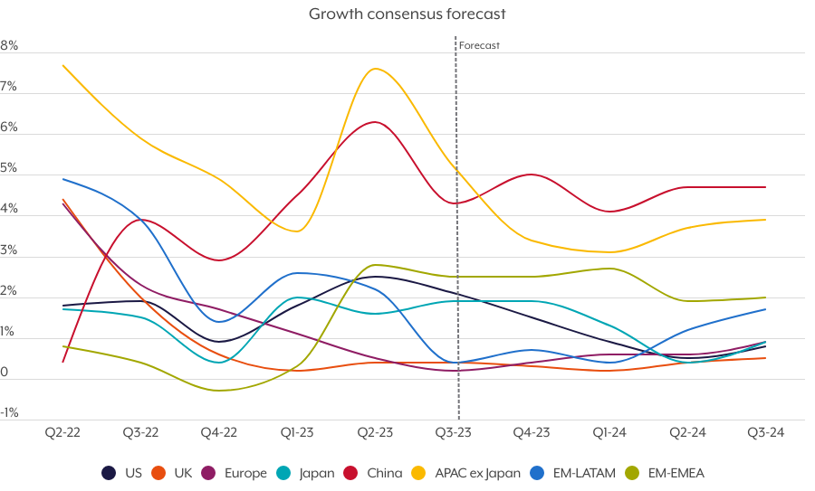
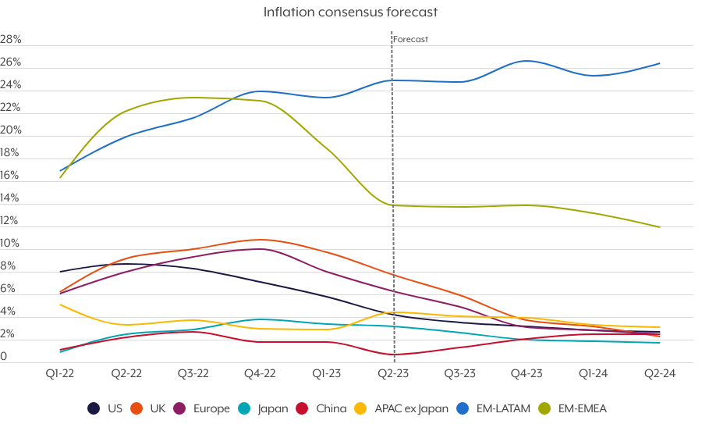
Growth and Inflation
Source: Bloomberg
Past performance is not a reliable guide to future returns

Slide 3
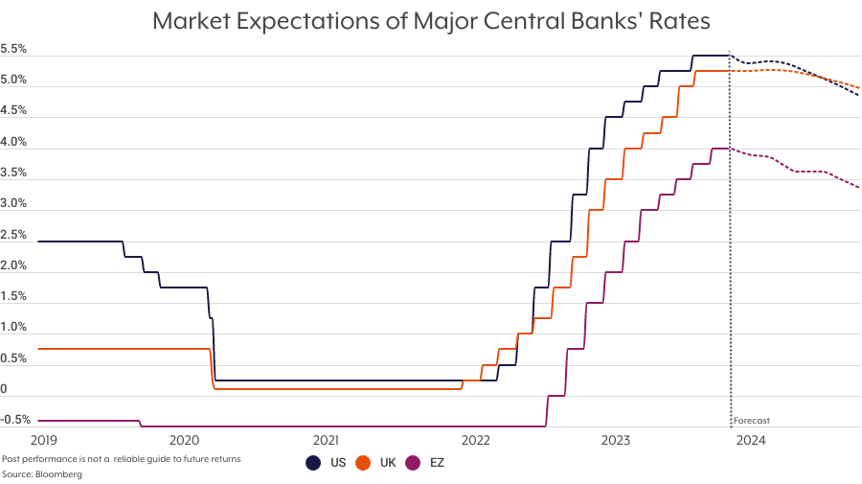
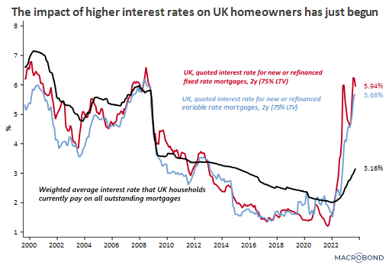
Interest Rates
Past performance is not a reliable guide to future returns

Slide 4
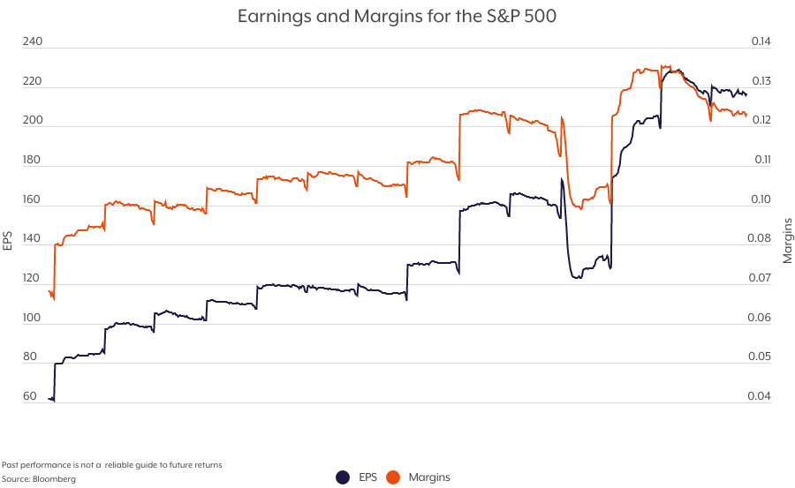
Company Earnings
Past performance is not a reliable guide to future returns

Slide 5
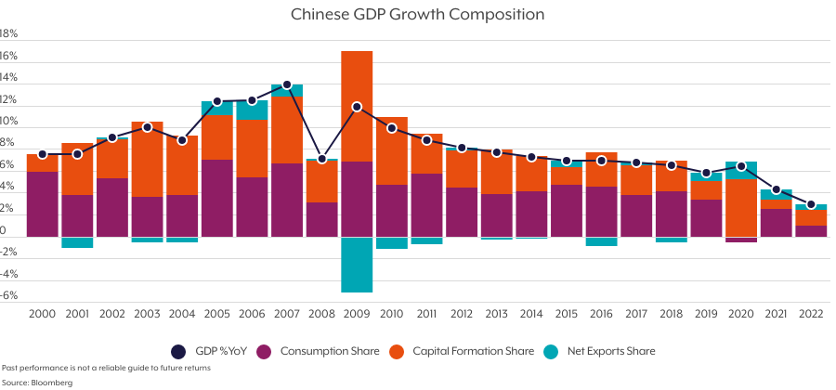
China
Past performance is not a reliable guide to future returns

Slide 6
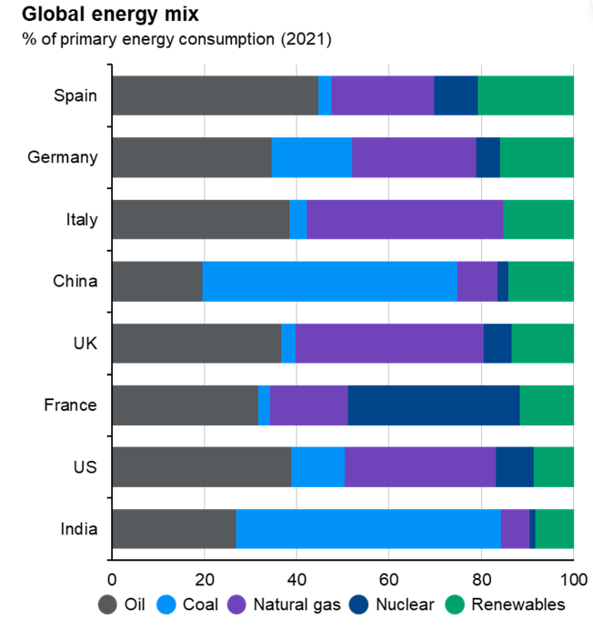
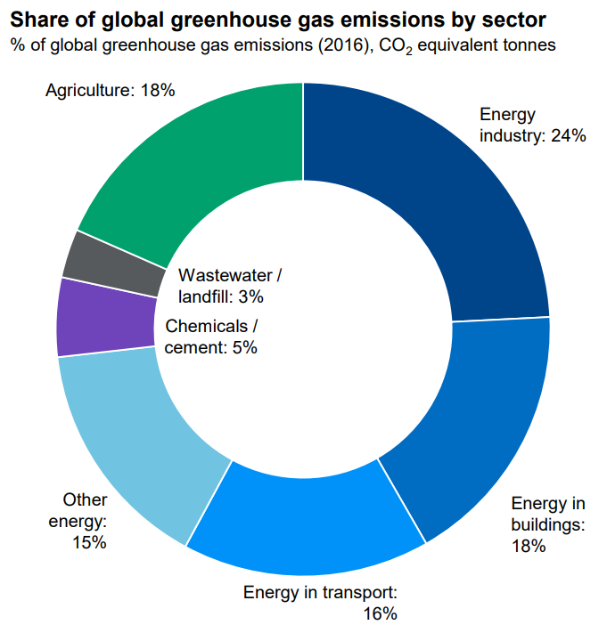
Green Thematic
Source: JP Morgan Guide to the Markets Nov ’23 - Climate Watch, Our World in Data, World Resource Institute, Renewables include hydro, wind, solar and biomass fuels.
Past performance is not a reliable guide to future returns

Slide 7
Central Macro Themes and Risk Scenarios
Bear Case
Downside risk scenarios
Base Case
Central themes
Bull Case
Upside risk scenarios
Growth
Central banks induce a deep and prolonged global recession or financial instability
Consumption collapses as savings evaporate and credit conditions become constrained
Inflation
Financial instability forces policy easing which creates another round of inflation
Stagflation as growth stifled without inflation being tamed
Other Considerations
Commodity prices reaccelerate
New geopolitical shocks
Growth
Growth slows with some shallow recessions
Inflation
At or near peak central bank policy rates. Tight policy stance through H1 24 until inflation and wages reliably moderate.
Global headline inflation falls, core sticky. Both remain at a tolerable level above 2% targets
Other Considerations
Energy and food prices stabilise at higher levels, risks remain to the upside
Green transition targets are reviewed to include energy security considerations
Trade frictions from geopolitical risks
Growth
Central banks engineer a ‘soft landing’
Savings drawdown and income levels insulate consumption
Inflation
Inflation falls more rapidly, easing pressures on the cost of living
Margin compression forces inflation to slow quicker than expected
Other Considerations
Diplomatic resolution of the Ukraine war
Source: Charles Stanley Investment Strategy Forum Sept ‘23

Slide 8
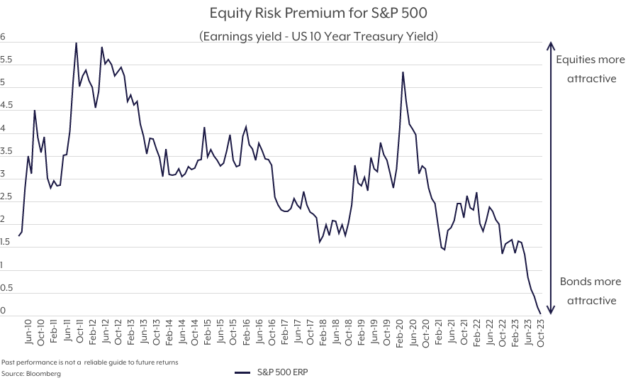
Portfolio Positioning
Past performance is not a reliable guide to future returns

Slide 9


Important information
    The value of investments can fall as well as rise. Investors may get back less than invested. Past performance is not a reliable guide to the future.
    Tax treatment depends on the individual circumstances of each person or entity and may be subject to change in the future.
    Although Charles Stanley's information providers, including without limitation, MSCI ESG Research LLC and its affiliates (the “ESG Parties”), obtain information (the “Information”) from sources they consider reliable, none of the ESG Parties warrants or guarantees the originality, accuracy and/or completeness, of any data herein and expressly disclaim all express or implied warranties, including those of merchantability and fitness for a particular purpose. The Information may only be used for your internal use, may not be reproduced or redisseminated in any form and may not be used as a basis for, or a component of, any financial instruments or products or indices. Further, none of the Information can in and of itself be used to determine which securities to buy or sell or when to buy or sell them. None of the ESG Parties shall have any liability for any errors or omissions in connection with any data herein, or any liability for any direct, indirect, special, punitive, consequential or any other damages (including lost profits) even if notified of the possibility of such damages.
    Charles Stanley & Co. Limited is authorised and regulated by the Financial Conduct Authority A member of the London Stock Exchange and is part of the Raymond James Financial, Inc. group of companies. Registered in England number 1903304.
    Registered office: 55 Bishopsgate, London EC2N 3AS.

