Slide 1
How data is transforming the funding landscape
ACO Conference, 12th September 2024
Tania Cohen

Slide 2
About 360Giving
We help funders publish open data about their grants, and support people to use this data to improve charitable giving.
Our vision is for grantmaking in the UK to become more informed, effective and strategic.
283 funders
Data on over 1.1m grants worth £265bn
Over 100,000 users access the data a year

Slide 3
Why publish data
Transparency and accountability
Demonstrate values
Raise awareness and profile of your work
See collective impact
Improve efficiency and outcomes
Understand yourself better
Support collaboration

Slide 4
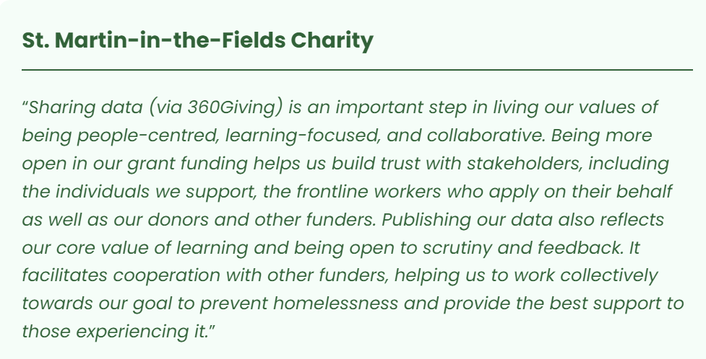
Why publish data

Slide 5
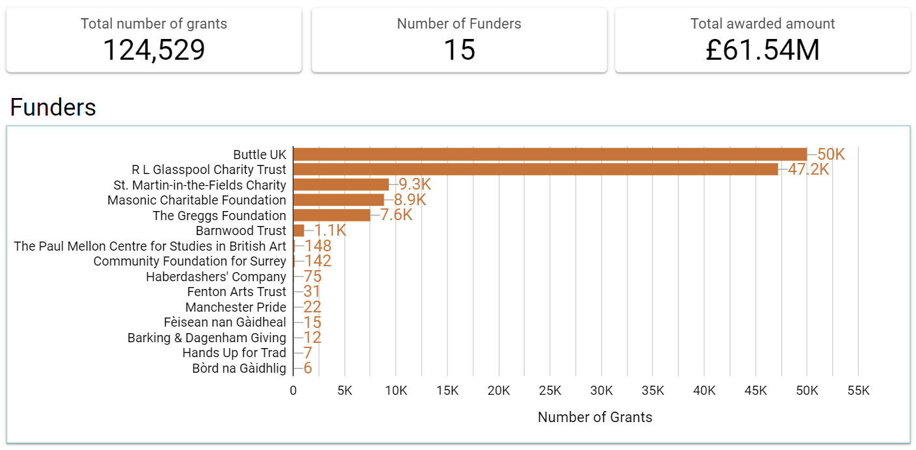
Award/Item Amount

Slide 6
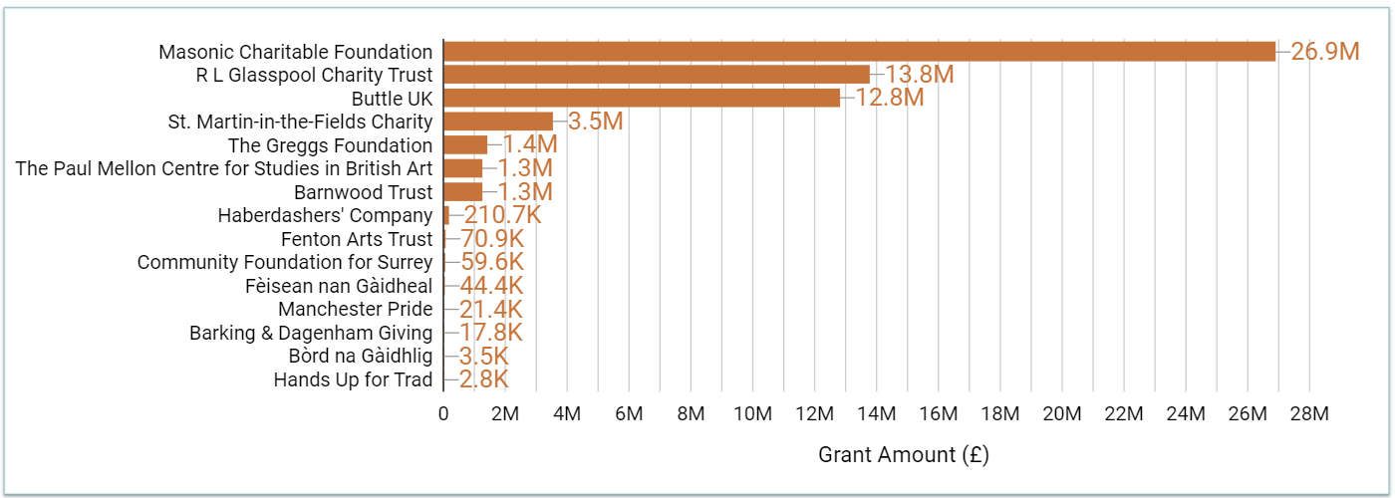
By value

Slide 7
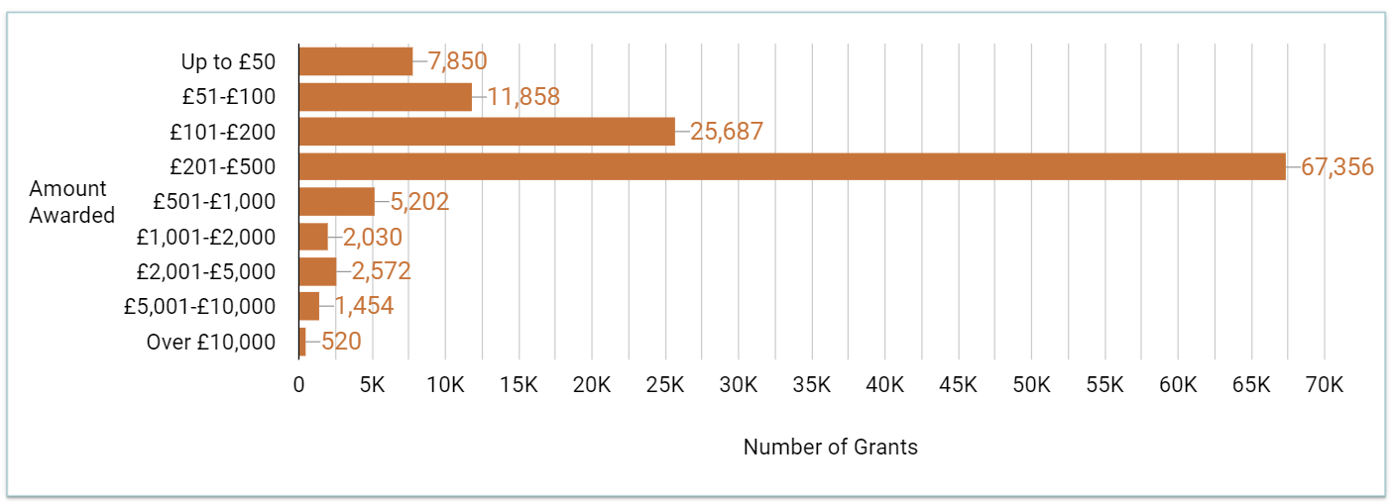
Award/Item Amount

Slide 8
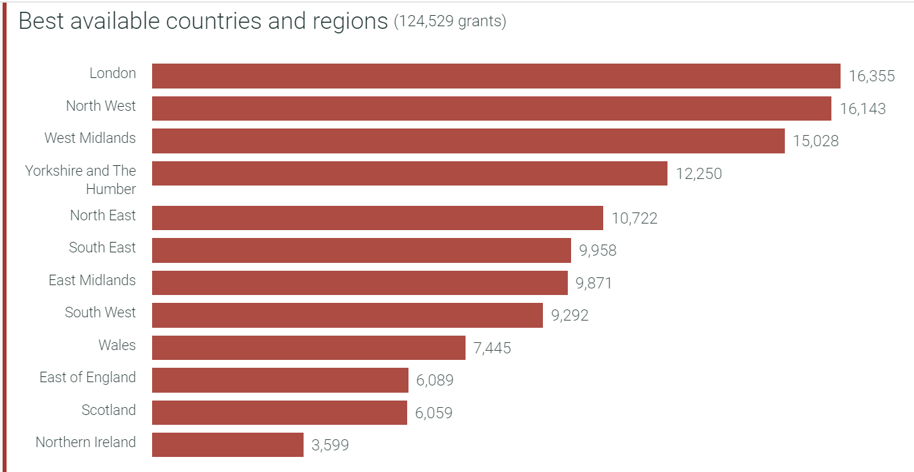
Grant location

Slide 9
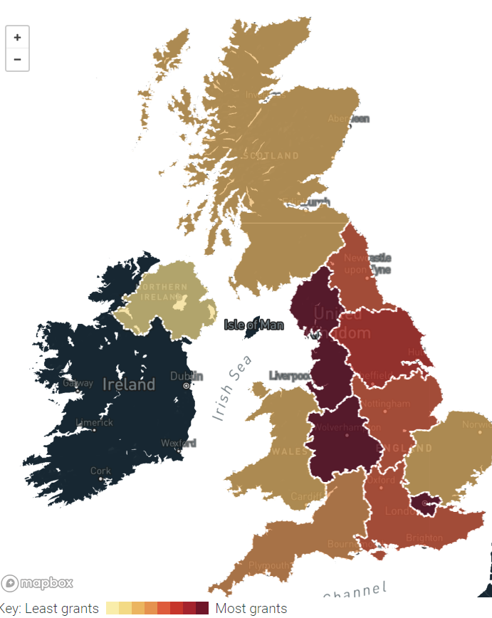

Slide 10
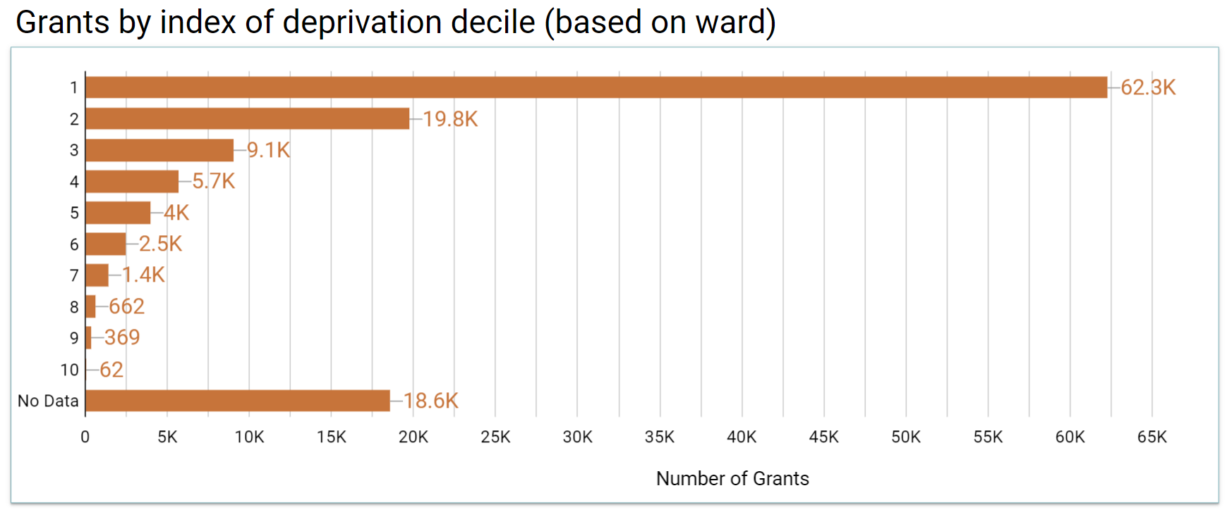
Index of deprivation decile
Grant recipients are in the 10% most deprived areas of the UK

Slide 11
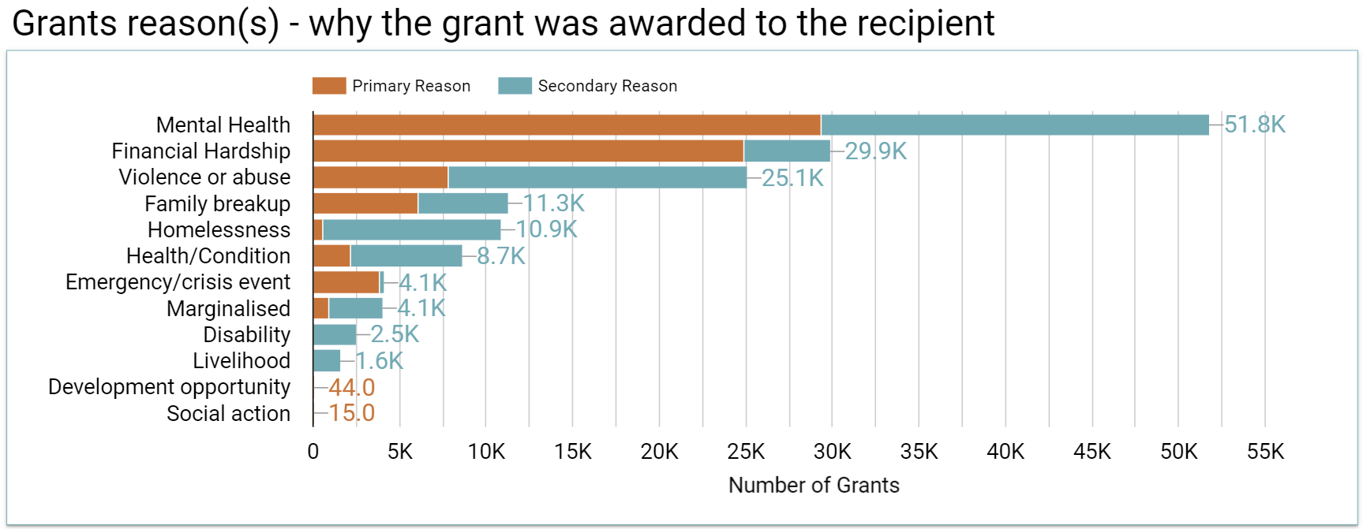
Grant Reason

Slide 12
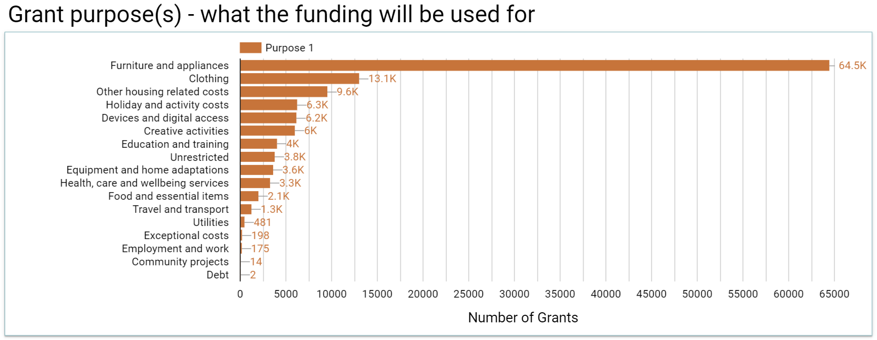
Grant Purpose

Slide 13
UKGrantmaking.org
Brought to you by
Supported by

Slide 14
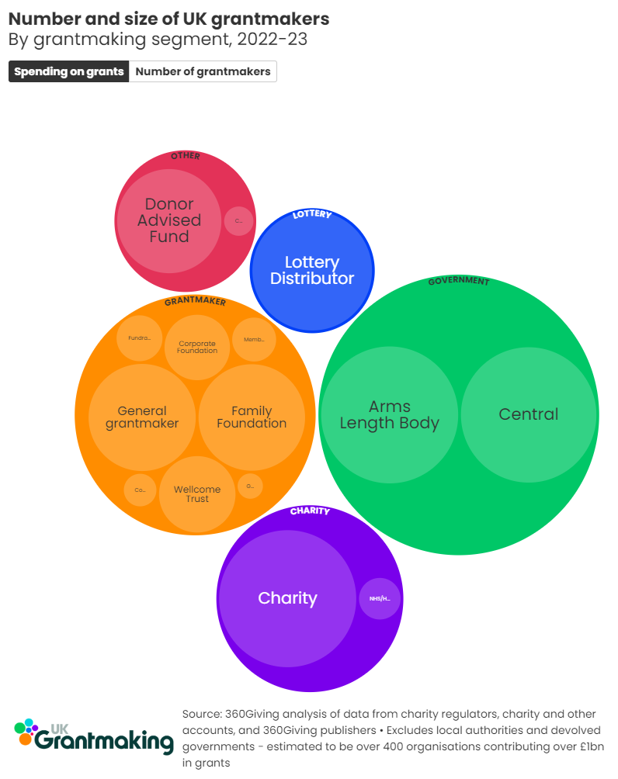
Spending on grants

Slide 15
Grantmaking to individuals, 2022-23
Segment | Make grants to individuals | Largest orgs with data available | Total grantmaking data available (£m)
Member/Trade Funded | 296 | 123 | 99.6
General foundation | 1,512 | 72 | 78.1
Operational charity | 115 | 24 | 35.9
Family Foundation | 22 | 14 | 27.1
Lottery Distributor | 6 | 6 | 16.1
Donor Advised Fund | 1 | 1 | 15.2
Fundraising Grantmaker | 27 | 18 | 13.9
Corporate Foundation | 20 | 12 | 8.7
Community Foundation | 33 | 21 | 5.1
NHS/Hospital Foundation | 3 | 3 | 2.4
Arms Length Body | 2 | 1 | 0.1
Total | 2,037 | 295 | 302.2

Slide 16
Largest grantmaking to individuals, 2022-23
Name | Net Assets (£m) | Grants (£m) | Prev year (£m) | Percentage change
Family Fund Trust | 12.8 | 35.1 | 33.0 | 7%
SSAFA, the Armed Forces Charity | 56.8 | 19.6 | 19.4 | 1%
The Rhodes Trust | 520.5 | 16.8 | 13.3 | 26%
Stewardship | 191.3 | 15.2 | 14.2 | 7%
Masonic Charitable Foundation | 386.5 | 11.1 | 12.6 | -11%
Royal British Legion | 378.1 | 10.9 | 9.0 | 21%
Creative Scotland | -22.2 | 6.4 | 5.5 | 18%
Association of Jewish Refugees | 20.9 | 5.9 | 4.4 | 34%
National Zakat Foundation (NZF) | 3.7 | 5.5 | 3.8 | 45%
Methodist Church in Great Britain | 279.1 | 5.1 | 3.5 | 47%
Clergy Support Trust | 116.0 | 4.8 | 3.2 | 52%
Buttle UK | 62.2 | 4.3 | 2.2 | 94%

Slide 17
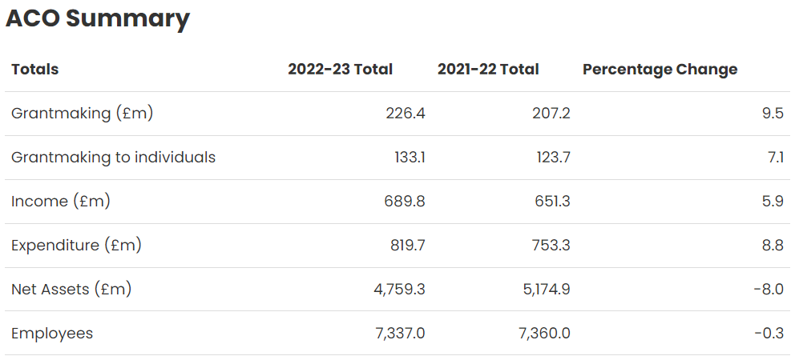

Slide 18
Support available
Guidance: standard.threesixtygiving.org
1-1 support: threesixtygiving.org/publishing
Workshops: threesixtygiving.org/workshops
Speak to us today!
Register now for 16th October

