Slide 1
Winter Warmth Network
Communications pack
Join our campaign to support vulnerable individuals and families to find holistic financial support this winter
www.lightningreach.org/winter

Slide 2
Fuel poverty & winter support in the UK
1/10
Excess winter deaths are directly caused by fuel poverty
6 million UK households are estimated to be in fuel poverty, struggling to afford even basic energy costs, a number that only rises as the cost of living crisis deepens.
There is a huge amount of support available for individuals, but the problem is often how to find it and navigate the complicated landscape and application processes.
For organisations, we know you excel at the specialist support that you provide, but can struggle to address an individual’s further needs and provide the holistic support required.
62%
Low income households have heated their home less than required
50%
Individuals with a disability are finding it difficult to pay their heating bills

Slide 3
The network: a collaborative approach
The Winter Warmth Network is a campaign running from 4 September 2024 to March 2025 which aims to connect the vast community of support organisations and professionals with the people who need help the most through the 2500 financial support schemes available Lightning Reach portal. That way, we will ensure that this winter, everyone gets the right support at the right time.
Full campaign details & activities can be found on the Lightning Reach website at www.lightningreach.org/winter.

Slide 4
Communications: aims
One of the main ways your organisation can get involved in the campaign is through communications to your network and user base. Through communications across a range of channels, we can:
1
2
Raise awareness of support
Promote new and little known support schemes via Lightning Reach to ensure individuals have the best chance of finding help that is tailored to them.
Reach more people in need
Increase access to financial support for vulnerable and underserved individuals by connecting them to over 2500 schemes via the Lightning Reach portal.

Slide 5
Communications: your channels
Primary call to action:
Find support this winter at https://apply.lightningreach.org/
Channels can include:
Email campaigns
Postal mailings
Posters & flyers
Newsletters & bulletins
Websites
Client apps
Email banners
In-person/digital events
Socials; Facebook, Twitter/X, LinkedIn, Nextdoor
Your winter communications
To spread the word, we would love for you to include Winter Warmth Network messaging and visuals in the regular communications channels you’ll be using this winter.
Please note, all clients looking for support should be sent to https://apply.lightningreach.org/ or your custom URL where applicable.
In the resources section below you will find resources and templates to use.

Slide 6
Communications: bigger opportunities
Examples
Do you have any press connections or opportunities that we can support you to progress?
Do you have any opportunities to input into newsletters or bulletins to other support organisations?
Are you hosting or attending any events with an opportunity to engage with individuals in need of support, or other organisations who support clients?
Making a splash with other opportunities
We’re keen to find big opportunities to promote the network and reach our mission, so we’d love to hear any additional ideas and opportunities you might have. As well as regular channels, how else can we reach individuals?
To discuss potential opportunities, please contact your Lightning Reach account manager.

Slide 7
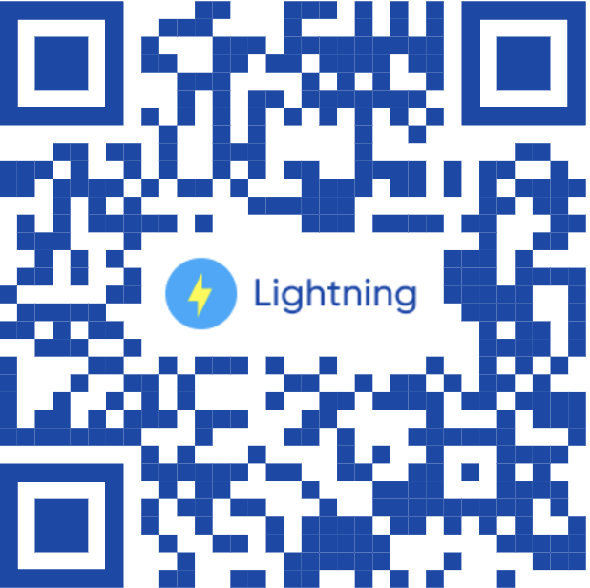
Next steps
Reminder: Custom URLS & QR codes
We can provide custom URLs for all of the comms you send so you can track how successful each channel is.
Please request the links you need from your account manager.
Please use the resources below to start planning your winter campaign. Your Lightning Reach account manager is on hand to discuss any ideas with you or your comms team.
And finally, spread the word!
Is there anyone in your network who could also join the Winter Warmth Network? Send them to www.lightningreach.org/winter to get them started.
Thank you for getting involved - together we can reach more individuals with the support they need this winter!

Slide 8
Resources

Slide 9
Logos & images
To tie the campaign together, we’d love you to use the Winter Warmth Network on your website and other communications. You can also include the Lightning Reach logo and images so your clients know what to look out for.
Download the logos here
We will add your logo to our campaign page and information.

Slide 10
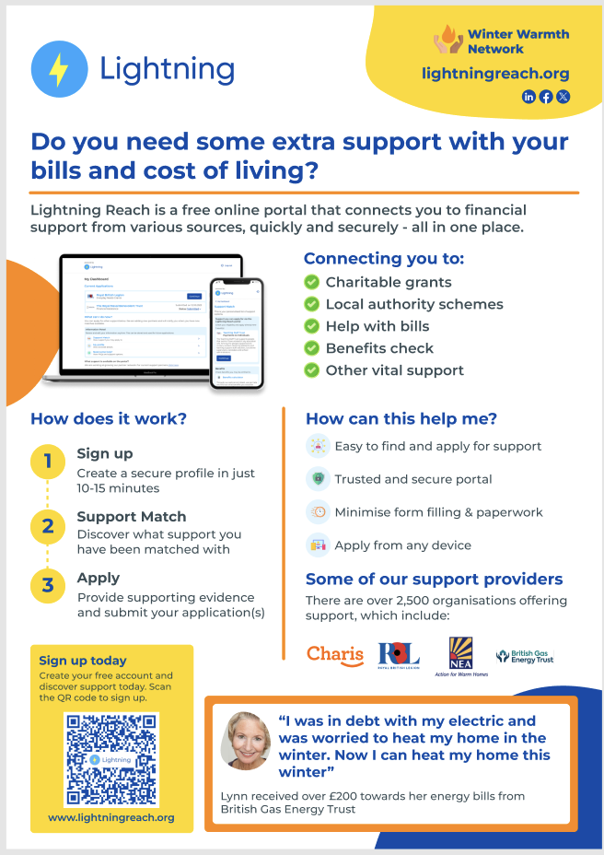
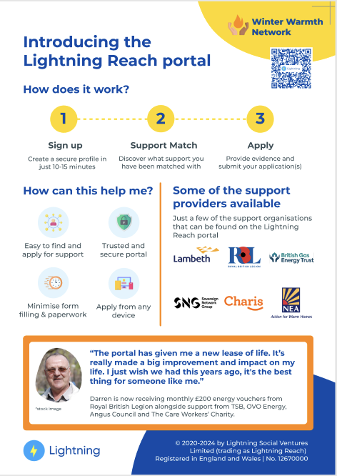
Flyers and posters
Use flyers and posters at in person events or community hubs to reach new clients.
Download the posters and flyers here.
Please let your account manager know if you would like a version with your logo on.

Slide 11
Emails, newsletters & websites
1
Email and postal campaigns
These can be a great way to engage existing clients in finding more support, or reach out to new individuals in need.
Newsletters
Do you have any regular internal or external newsletters that could be used to spread the word to staff and clients?
Website or app
Adding information and a link to Lightning Reach on your website can be a great way to catch the attention of individuals.
2
3
Please find suggested copy for any written comms here.

Slide 12
Case studies & quotes
Case studies can be an excellent way to demonstrate impact for clients.
Find a list of energy and winter related case studies and quotes here. Please feel free to use these across your channels.
“It had a huge impact on me and my son’s life. I was able to buy him some winter clothes - coats, hats and scarfs for school and winter time.” Maria, Lightning Reach user

Slide 13
Key facts and figures
To date, £12 million has been awarded to individuals by Lightning Reach partners, directly through the portal.
A further £3 million is estimated to have been awarded through other Lightning Reach support matches.
The average successful applicant receives £1070.
Over 130,000 individuals are registered on the portal.
Full facts and figures can be found in our impact summary here.
Please note, some figures have been updated since, the stats in this slide are the most recent.
Top 5 types of funding received by applicants
Energy and utilities
Food & essentials
Furniture & appliances
Clothing
Housing costs

Slide 14
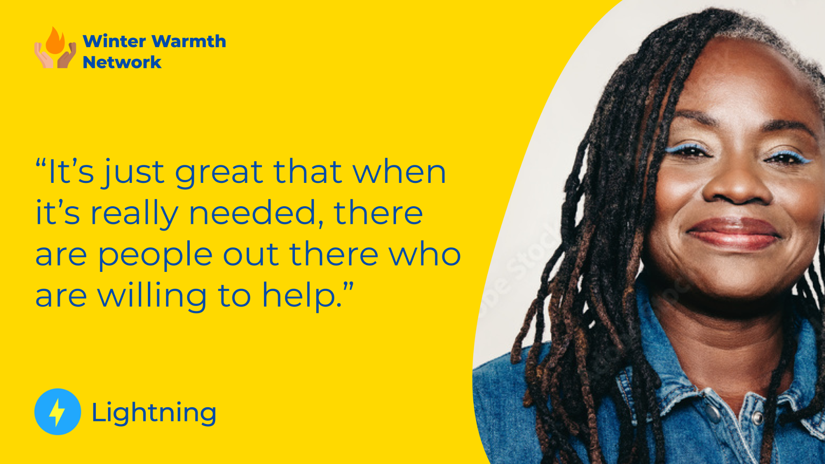
Social media
We’ll be spreading the word on Facebook, LinkedIn and Twitter/X. We’d love you to interact with our posts, and we will do the same back!
Please find a socials card for your organisation in the folder here; you can use the suggested text here.
Please tag us and use the hashtag below on your posts.
#WinterWarmthNetwork
@LightningReach

Slide 15
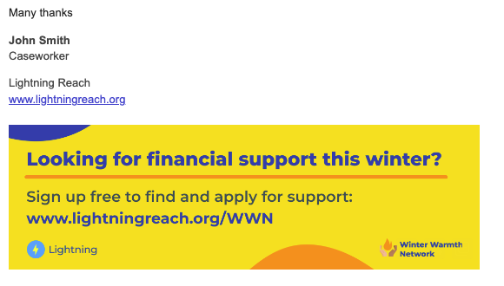
Email banners for client facing staff
Messaging through client facing staff can be a great way to engage individuals. Using email banners is a great way to remind clients that they can use Lightning Reach every time they receive communications from your team.
Download the email banners here.
Please let us know if you would like a version with your logo on.

Slide 16
Any questions or not sure where to start?
We’re here to help! Your Lightning Reach account manager will be on hand to guide you through.

