Slide 1
Campaign to support survivors of domestic abuse .
Launched 16th June 2024

Slide 2
The campaign was designed to raise funds which would quickly and distreetly provide a £200 unrestricted grant to survivors of domestic abuse.
Crowdfunder hosted the campign to generate funds through pedges from the public.
Lightning Reach providing the application portal through which applications to the fund were made by survivors of domestic abuse.
National Benevolent Charity was the campaign “face”, validated applicants and uthorised grants. Cash Perks delivered cash grant payments via ATMs

Slide 3
The initial aim was to raise £20,000 - to do this
All partners marketed to their audiences and shouted about their participation
Crowdfunder focussed on a number of placements in its social media and did a PR campaign to drive pledges
NBC rounded up partners for their support
Cash Perks / Lightning provided recipient survey data for stories which fed back into the loop
CF will send stories to current backers to encourage more from existing and use across socials to attract more. All parties to engage with this.

Slide 4
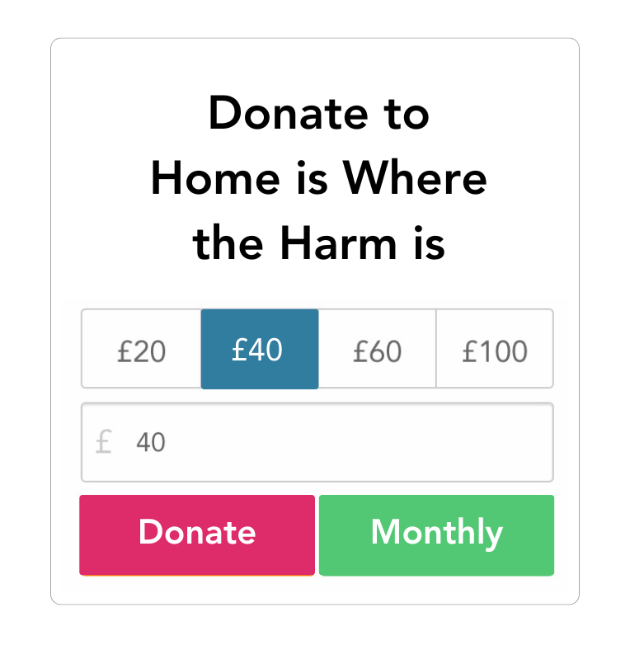
Partners begin to share with networks
(Us, partners, paid social)
Share stories with backers
Updates 6
Call to Action
Stories & updates
Keep
helping
Donate & share
Donations are received
Beneficiaries receive funding
Distribute fund & survey

Slide 5
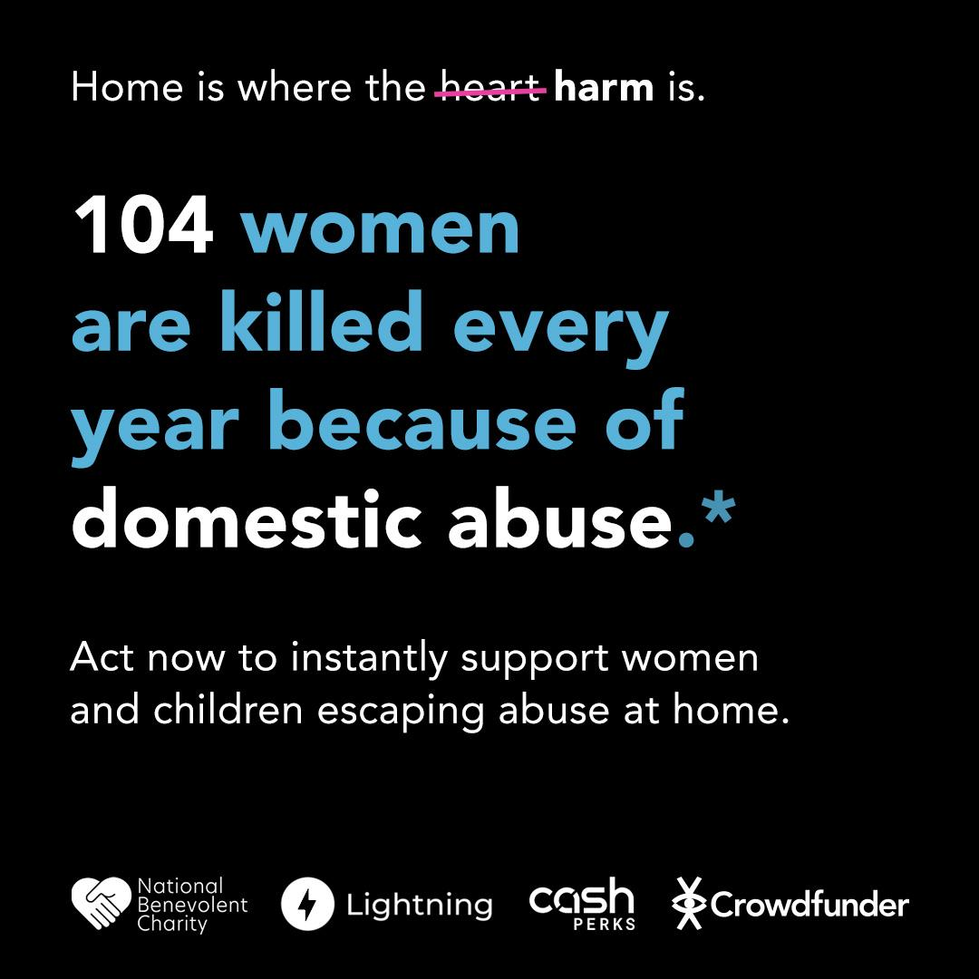
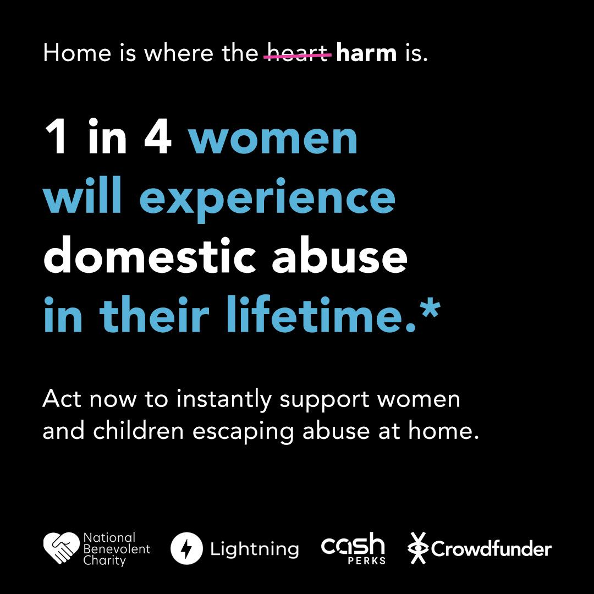
The Problem.
General assets

Slide 6
Launch
The start of the Euro 2024 football competition in June provided an opportunity to align the campaign with repeated stories around the increase of Domestic Abuse cases during England matches.
Initial campaign launched on Sunday 16th June ahead of England’s first game with the target to raise the initial £20,000, then extended as required
CF spent circa £1,500 in paid social media advertising to significantly increase the awareness of the campaign and to reach 220,000 targeted people encouraging them to make a difference by donating.
Researchers at Warwick Business School discovered abuse and violence by partners increased by 47 per cent on the day England won a World Cup or European Championship match.
The study found domestic abuse remained higher than average on the day after a tournament win, with reports of cases involving alcohol 18 per cent higher than average.
Researchers, whose findings were published in Social Science and Medicine, analysed a decade of crime statistics from West Midlands Police stretching from 2010 to 2019. LINK

Slide 7
The Campaign

Slide 8
Our campaign is a lifeline for helping those in harm's way, it’s:
Sending instant support to women and children escaping domestic abuse.

Slide 9
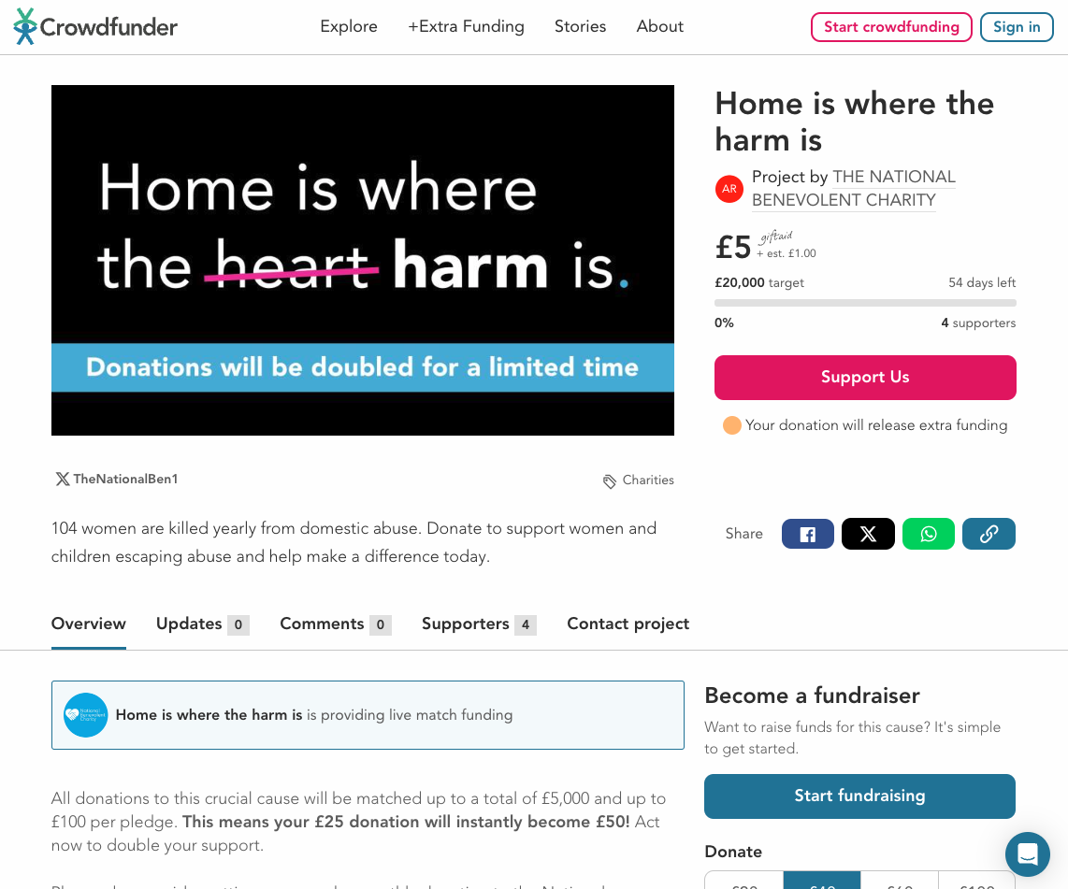
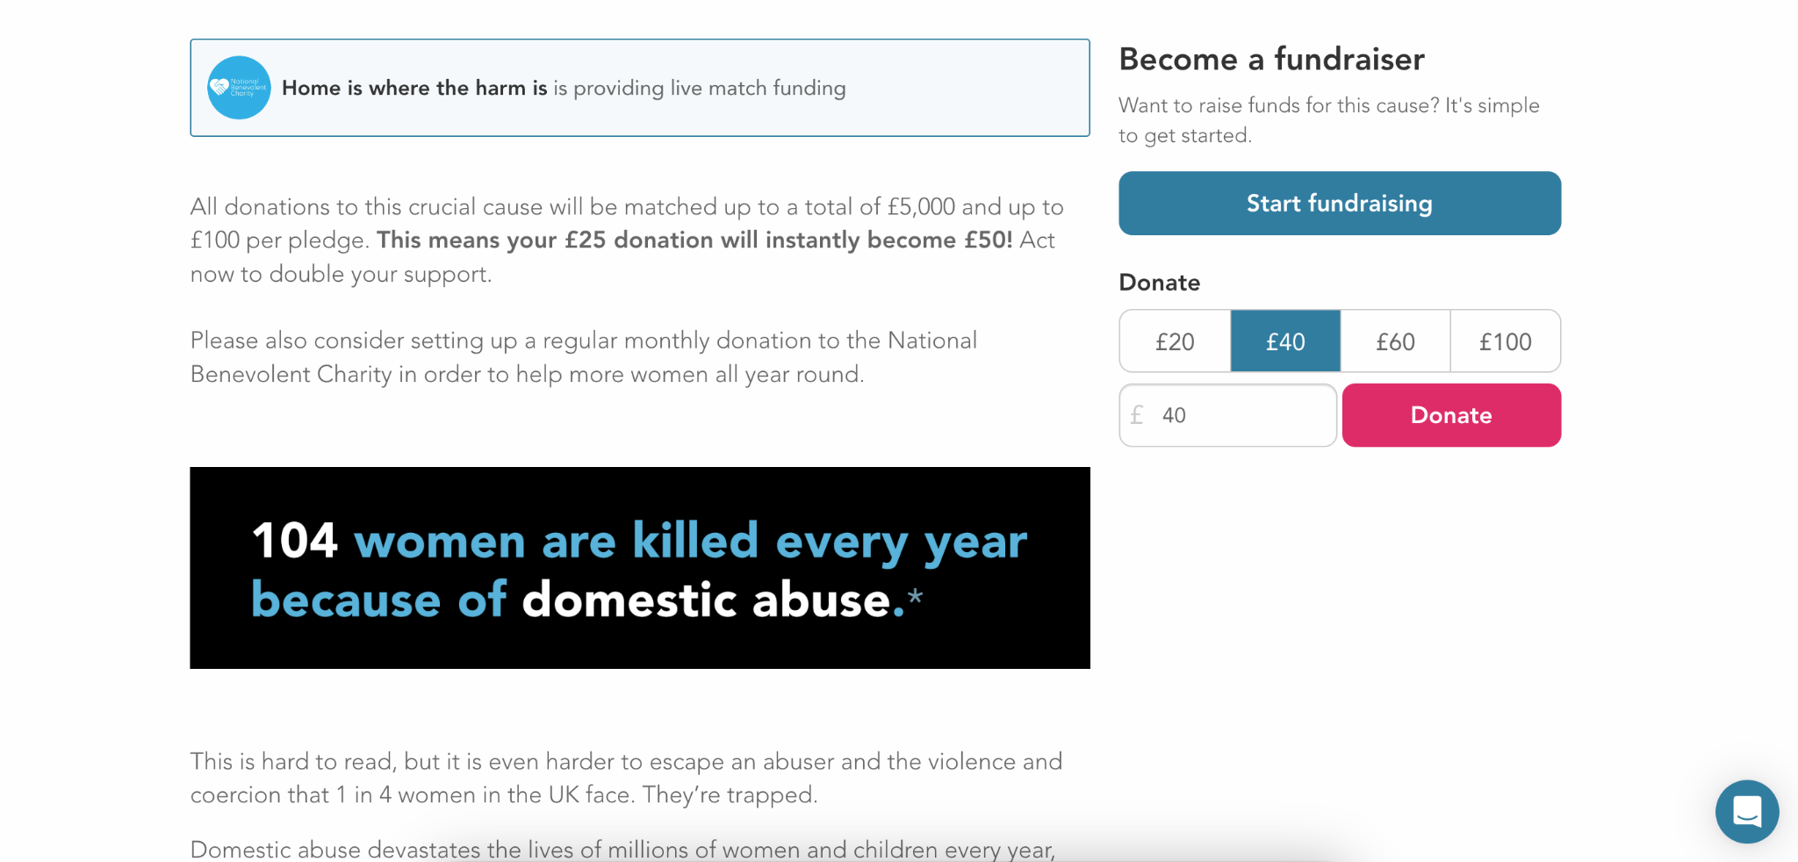
Project page.

Slide 10
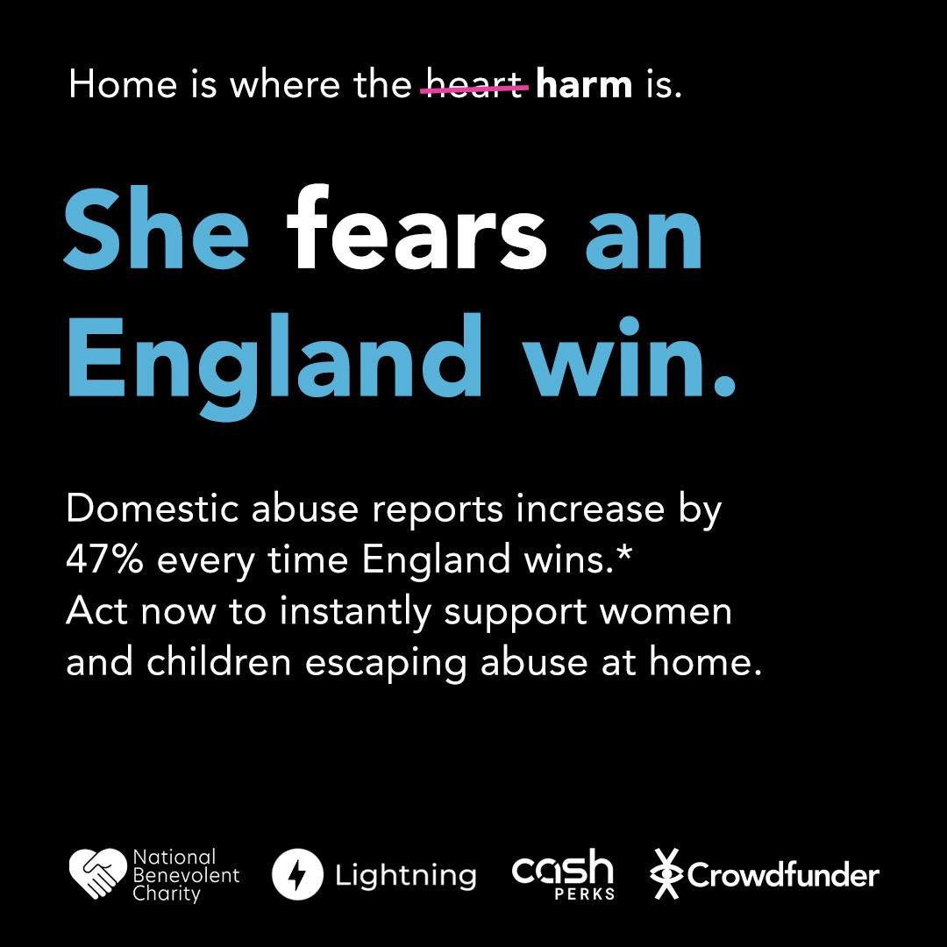
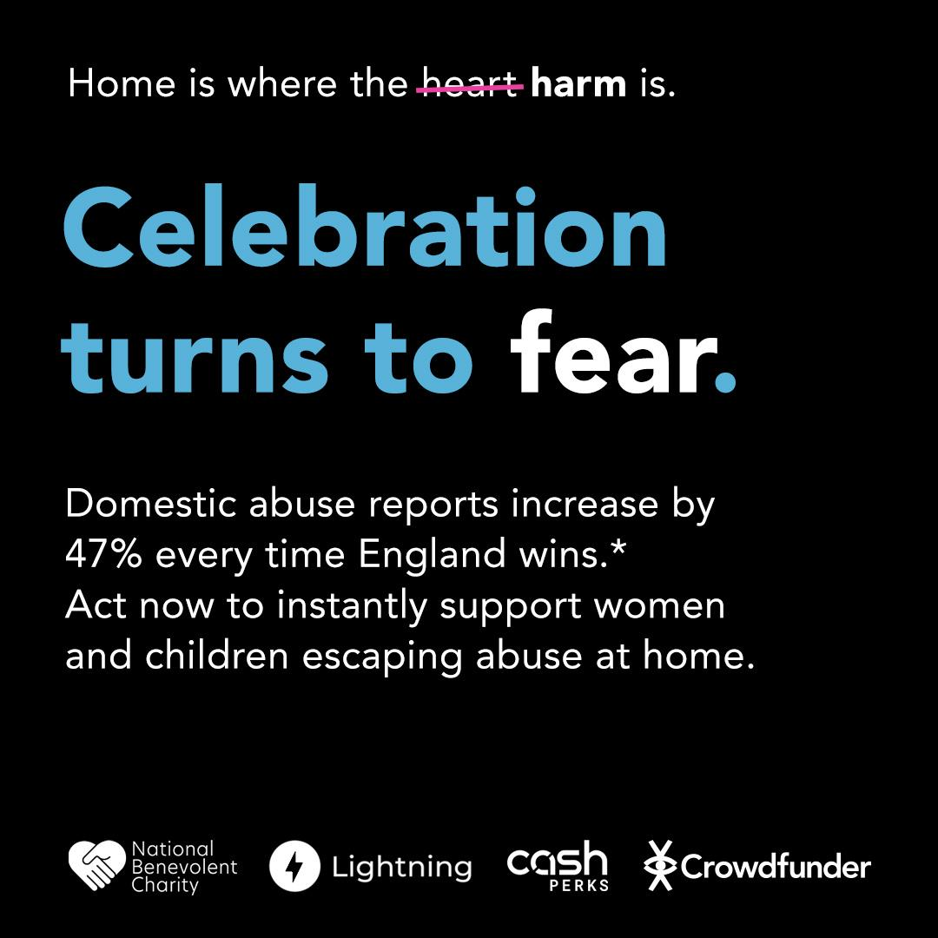
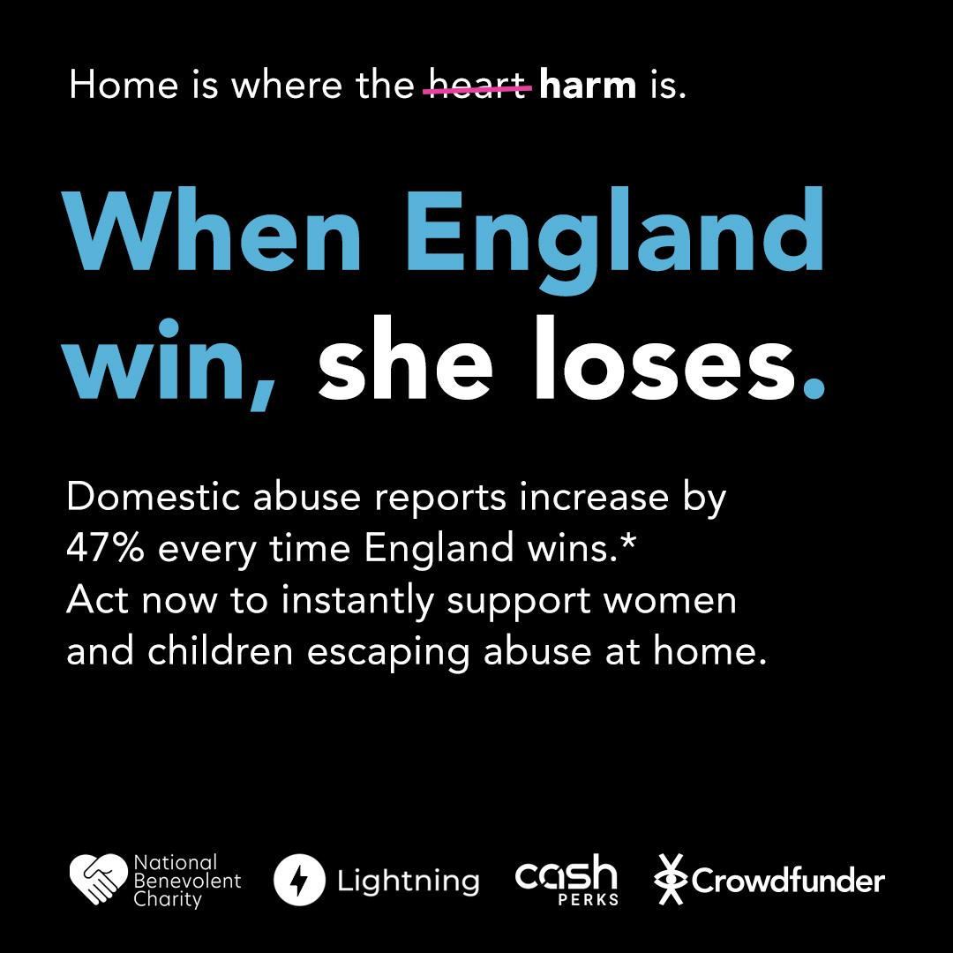
Social
assets.
Example launch assets - Euro focused

Slide 11
Social advertising.
Paid Facebook/Instagram social ads
Utilising Meta’s behavioural targeting, CF reached people who showed an interest in charitable causes as well as lookalike audiences.
They also constantly tested and checked to see where the ads had most impact.

Slide 12
Video ad.
Download video

Slide 13
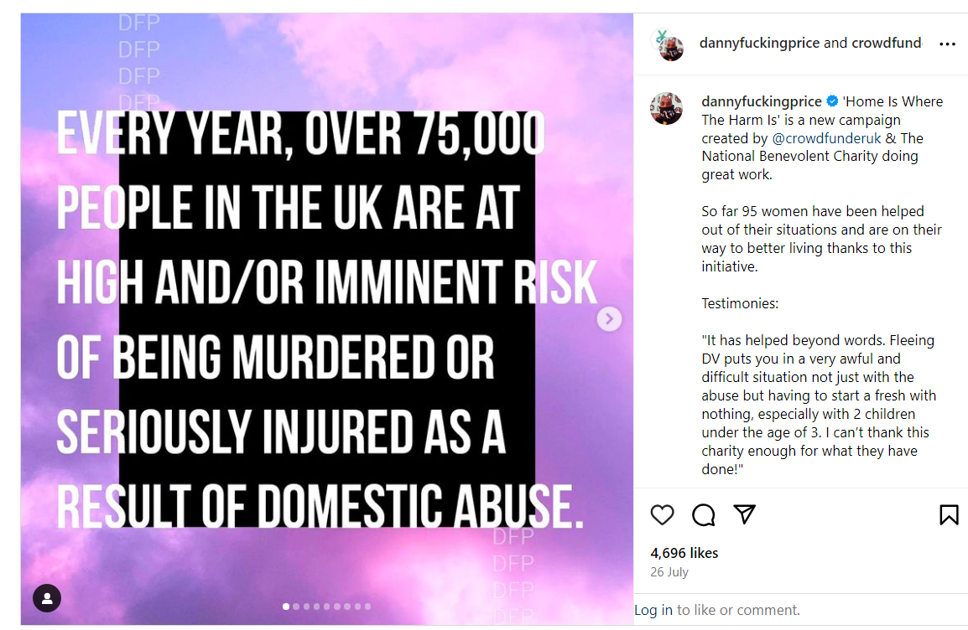

Slide 14
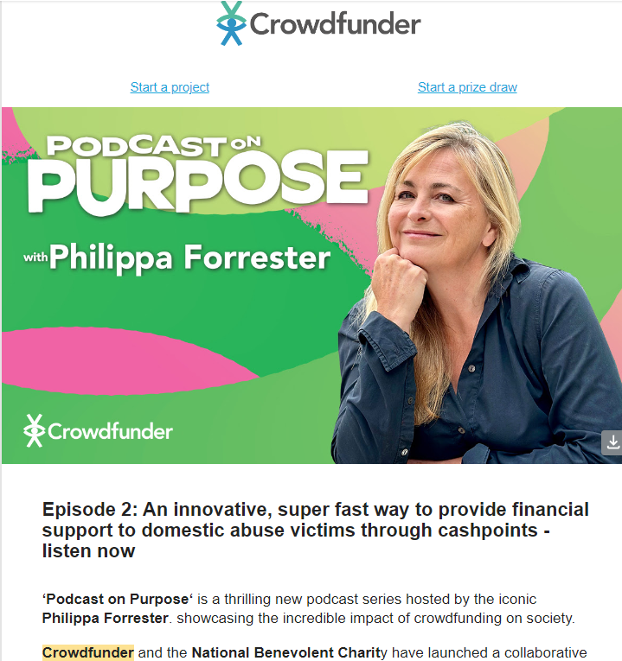

Slide 15
How did we do?
Raised £13,000 in four days
British Airways came on board very early with £5,000
Made first payment within 10 days
Initial £20,000 target was reached by 20th July
Campaign has raised £22,297 – current target £25,000
It has 499 supporters
Enabled Nat Ben to make 110 awards
Applying for a Digital Leaders Award

Slide 16
“It has helped beyond words. Fleeing DV puts you in a very awful and difficult situation not just with the abuse but having to start a fresh with nothing, especially with 2 children under the age of 3. I can’t thank this charity enough for what they have done!”

Slide 17
Learning ?
The premise of using tech for good worked
The public donate to benevolent charities
Risk was low although reputational damage was risk assessed
Getting partners on board almost impossible e.g. Womens Aid/Refuge
Need a high level “expert” marketing campaigner
Partners worked well together – cooperating when things went wrong
Hard to scale - up
Early momentum and match funding helped drive donations
Managing funds and applications critical

