Slide 1
Neurodiversity Awareness Campaign: Bridging Understanding, Breaking Barriers
Kirstie Pickles BVMS PGCert(CounsSkills) MSc PhD CertEIM DipECEIM MRCVS FHEA
Vetlife Trustee

Slide 2
Vision & Mission
Vision: A UK veterinary community with high levels of physical and mental wellbeing.
Mission: Vetlife provides support to members of the UK veterinary community and their families who have emotional, health or financial concerns, whilst seeking ways to prevent such situations in the future.
Notes:
For over a century, Vetlife has supported the UK veterinary community.
Vetlife provides support to the veterinary community 24 hours a day, every day of the year.- three main services, Vetlife Helpline, Vetlife Health Support, and Vetlife Financial Support.
You don’t need to be a member of Vetlife to use our services – they provided by Vetlife as a charity and free to use for the veterinary community.
Helpline 11 contacts per day.
postvention support to the veterinary community since 2009.

Slide 3
Background
Anecdotal reports of distress in neurodivergent veterinary community
Autistic vet wellbeing poor compared to general vet population
Stigma and lack of neurodiversity awareness frequently cited as sources of workplace stress
Smits F, Houdmont J, Hill B, Pickles K. Mental wellbeing and psychosocial working conditions of autistic veterinary surgeons in the UK. Vet Rec. 2023;e3311. https://doi.org/10.1002/vetr.3311

Slide 4
Neurodiversity Awareness Campaign

Slide 5
Planning
Internal committee
Structure & remit
Broad content outline
Timeline
Costings
Working party
Chair from Vetlife
Neurodivergent veterinary community
Employers
Educators

Slide 6
Content: Blogs
Series of blogs of lived experience
The post-diagnosis rollercoaster
Living with dyslexia
Living with ADHD
Navigating OCD as a veterinary professional
Dyspraxia in veterinary practice
Managing dyscalculia as an RVN
Life as a farm vet with autism
My experience as an RVN/JVP with ADHD
Autism and workplace challenges

Slide 7
Content: Video

Slide 8
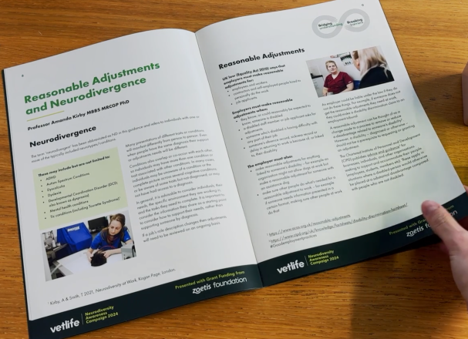
Content: Resource
Comprehensive, free, written resource
Language and neuroinclusion
Lived veterinary community and expert-led information on conditions
Guidance on navigating the process of reasonable accommodations

Slide 9
Content: Practice Poster
For display in the workplace to highlight the campaign
Freely available, two formats
Key campaign messages
QR code to written resource

Slide 10
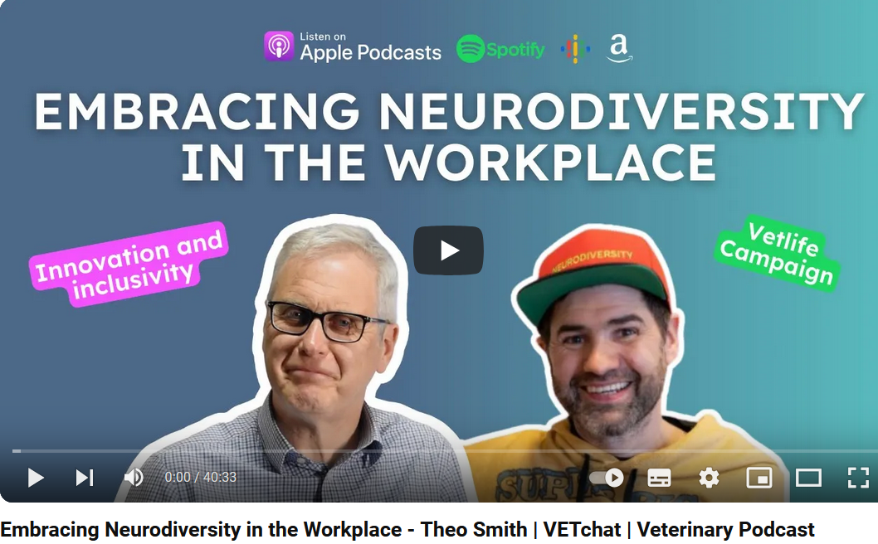
Content: Talks
Series of talks on neurodiversity at key veterinary conferences throughout 2024
Webinar and podcast, free to download

Slide 11
Advertorial
Published in The Vet Record, the official journal of the British Veterinary Association

Slide 12
Feedback
This is fantastic. A huge thank you and well done to the Team at Vetlife
This is brilliantly informative and well presented, and very much needed
It was such an informative and inspiring talk!
Overwhelmingly positive
Survey planned for 2025 to gather feedback and investigate how understanding of neurodiversity has changed
A great insight into proactive thinking around neurodiversity and people who are neurodivergent

Slide 13
Questions? Info@vetlife.org.uk

